Slide 1
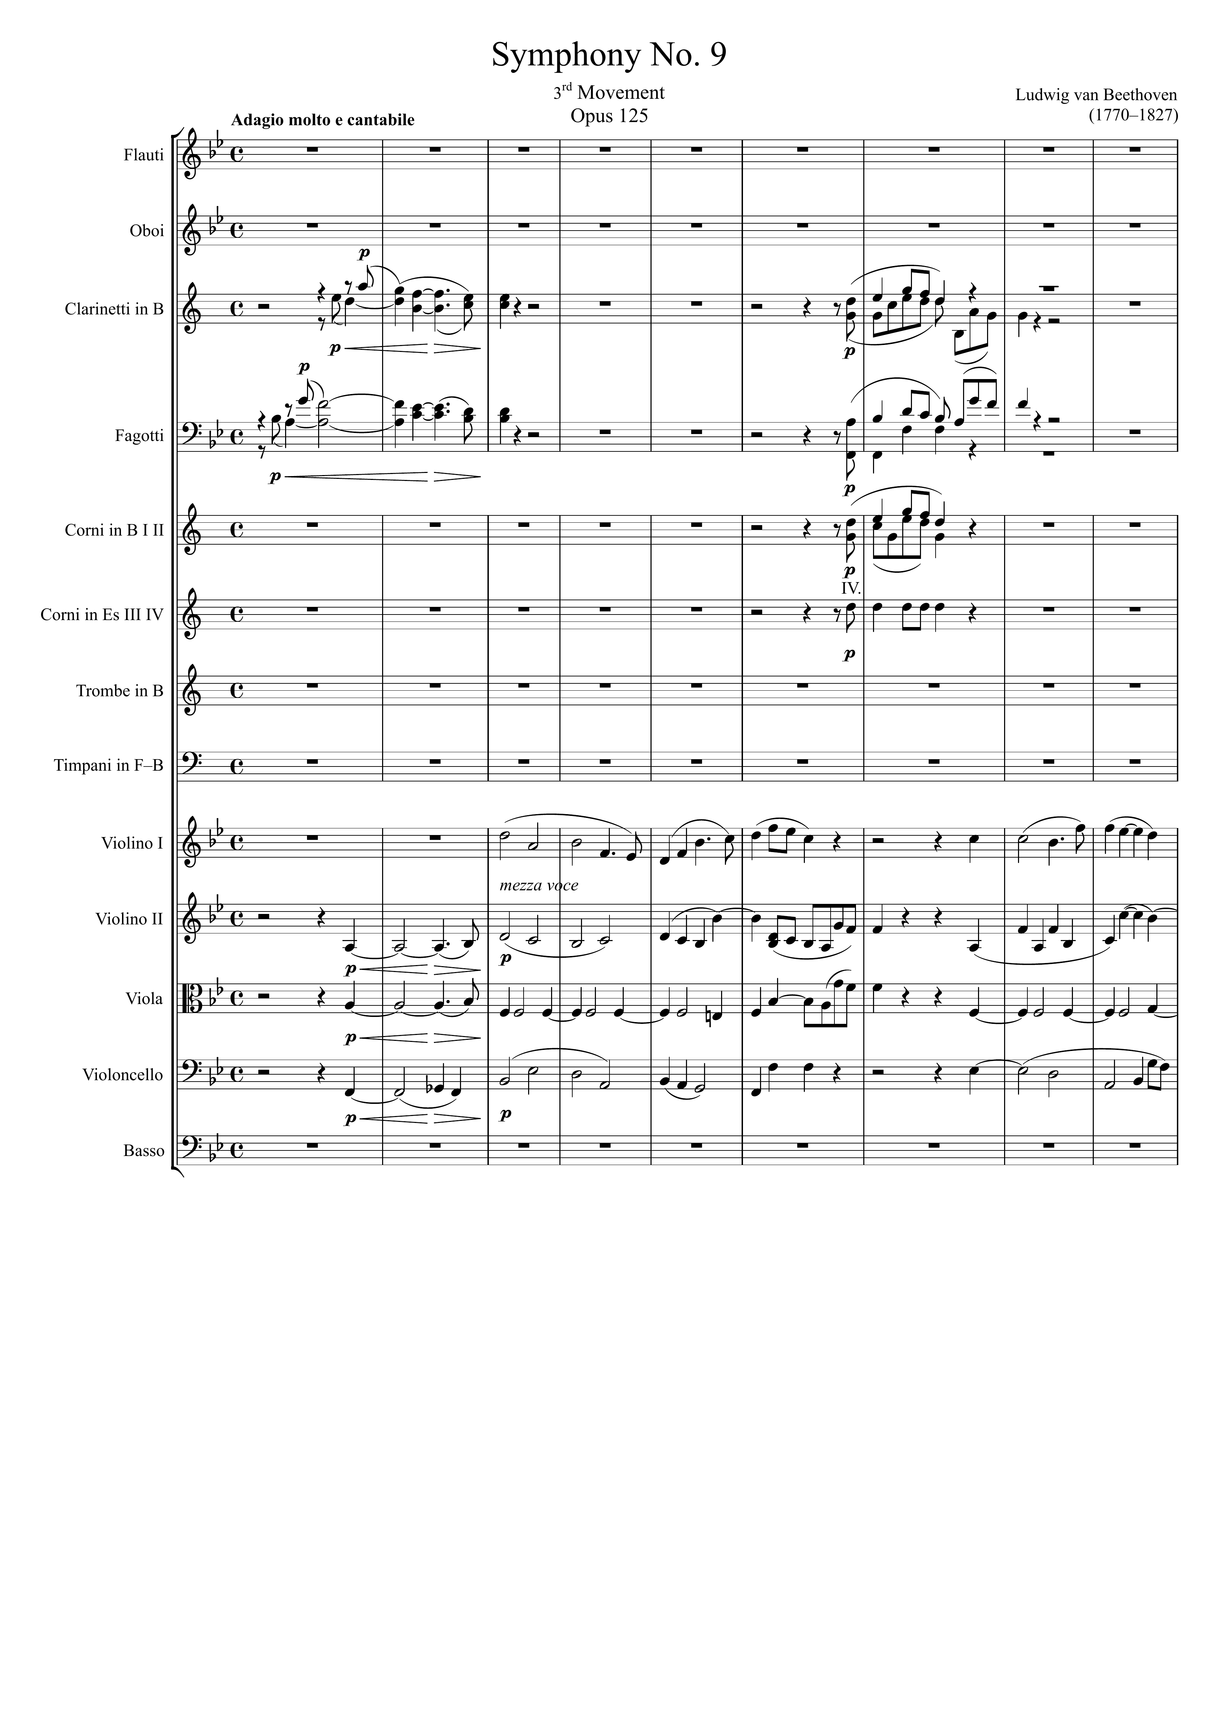
5
mel
mel
harm
mel
mel
harm
mel
harm
harm
mel
mel
mel
harm
mel
harm
harm
mel
harm
harm
harm

Slide 2
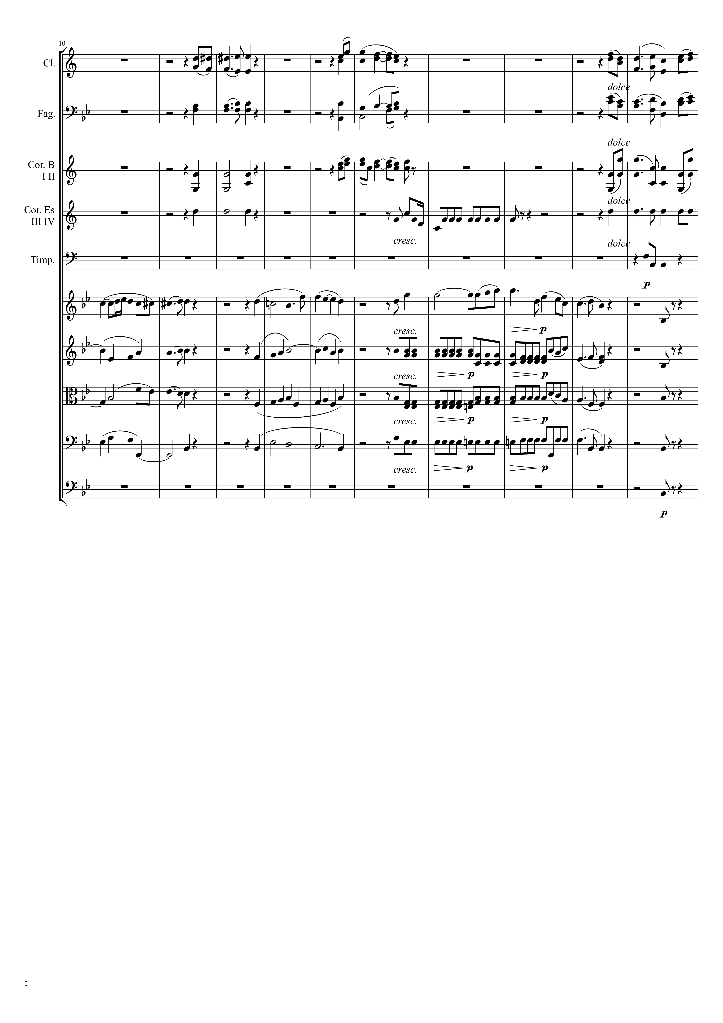
10
mel
15
mel
mel
harm
harm
harm
harm
mel
harm
harm
mel
harm
harm
harm
harm
harm
harm
mel
mel
mel
harm
harm
harm
harm
harm
harm
harm
harm
harm
harm
harm
harm
harm
harm

Slide 3
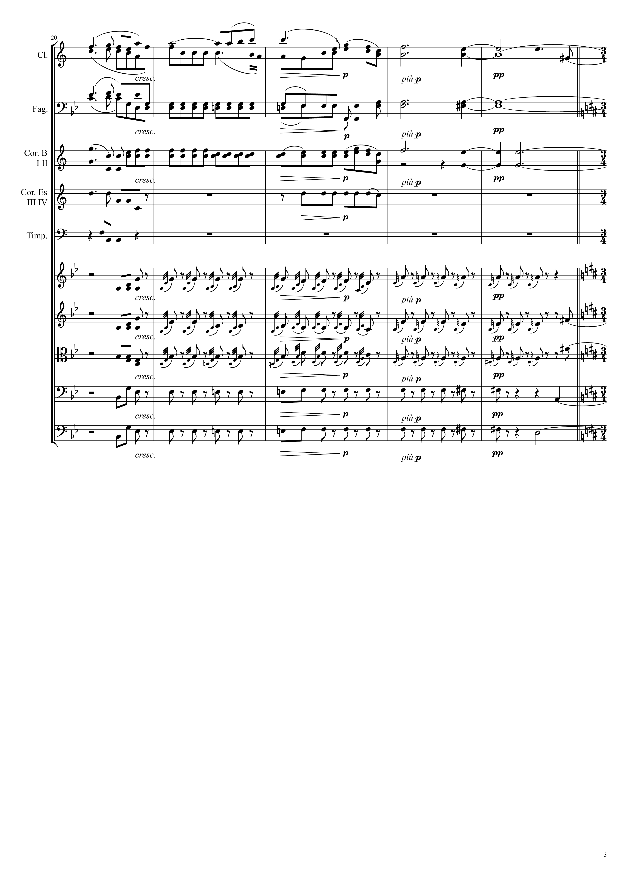
mel
mel+harm
harm
harm
harm
harm
harm
harm
harm
harm
mel
harm
mel
harm
harm
harm
harm

Slide 4
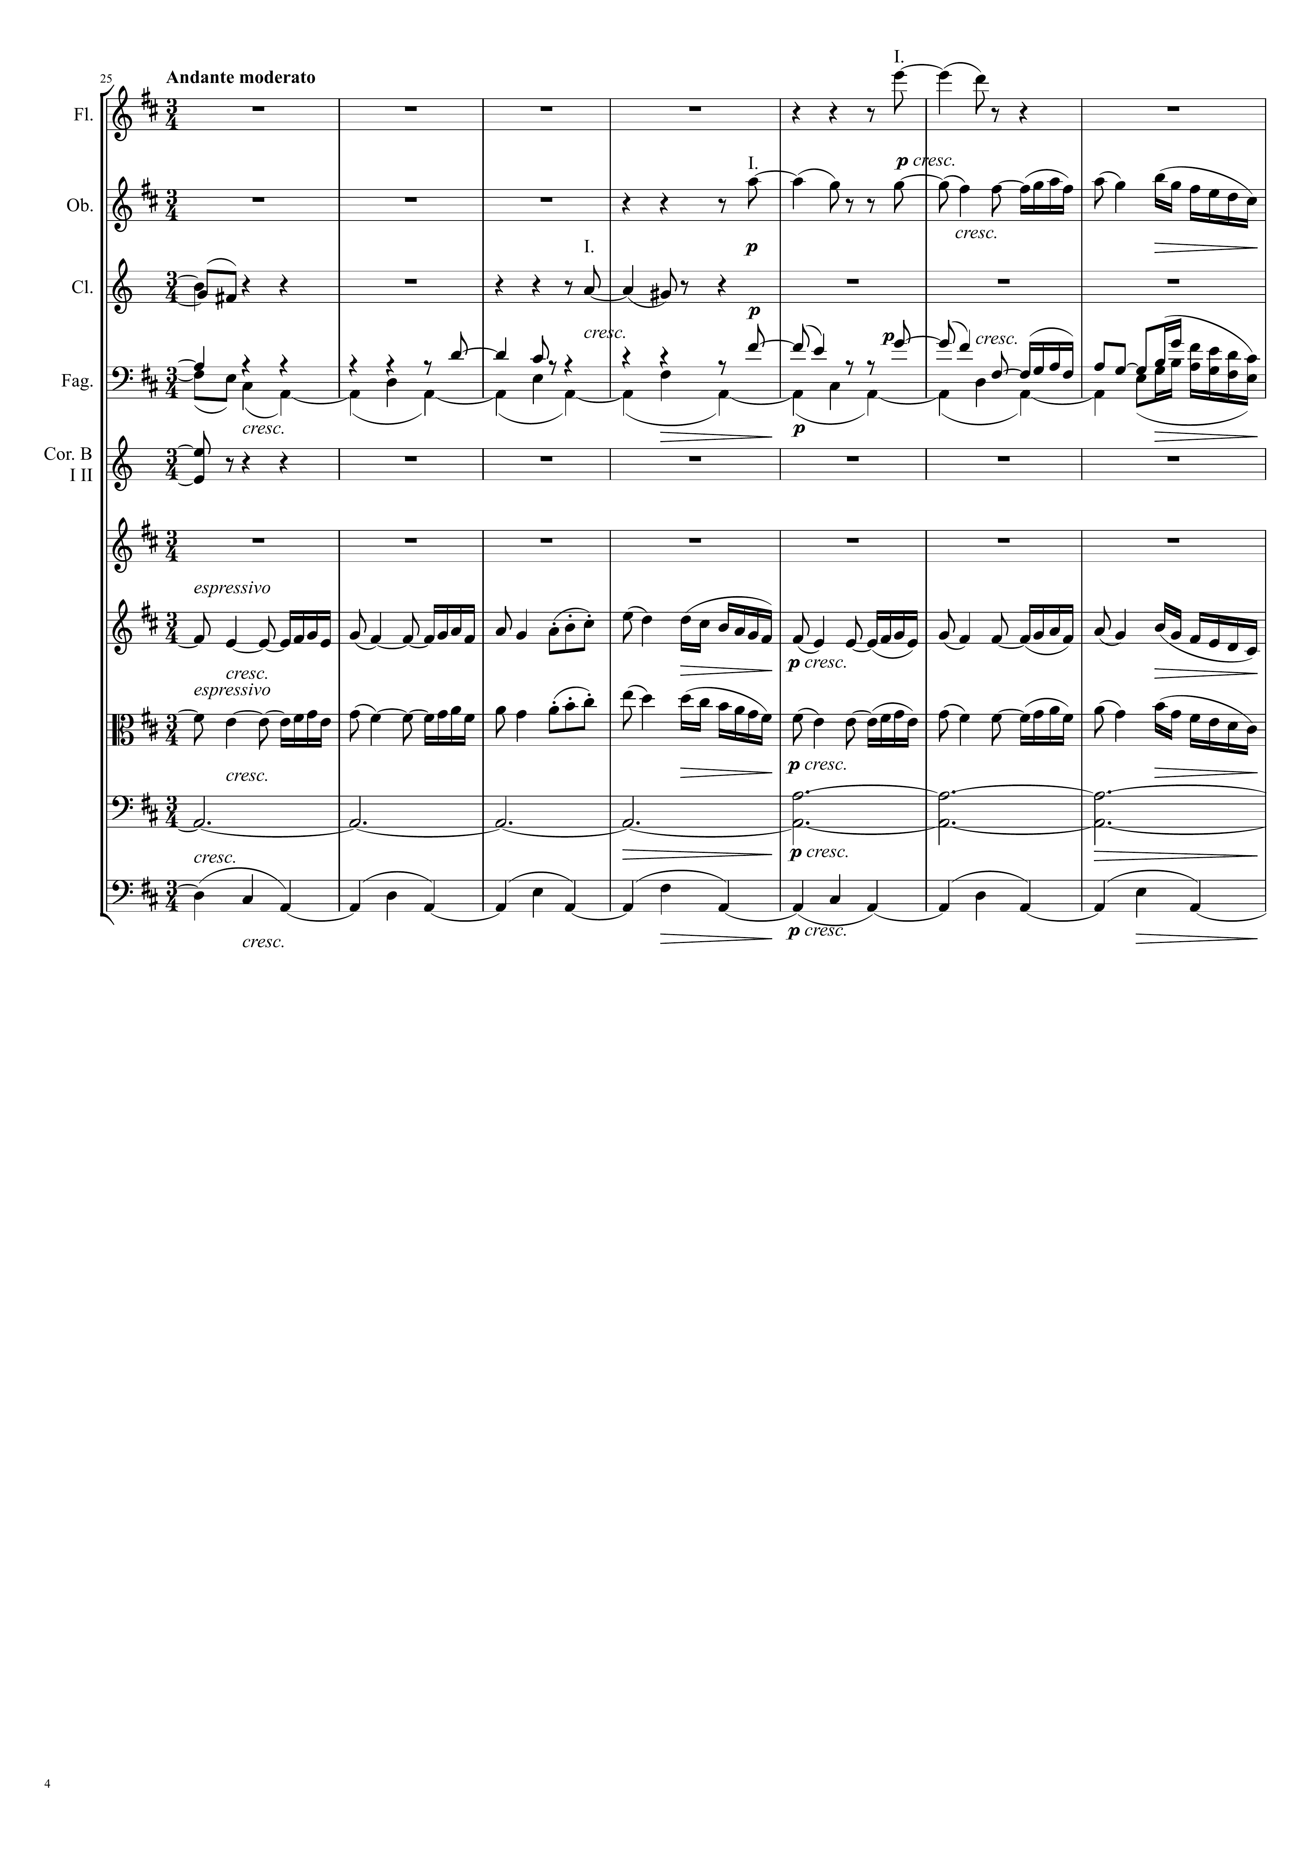
mel+harm
mel+harm
harm
mel
harm
harm
harm
mel
harm
mel
mel
harm
harm

Slide 5
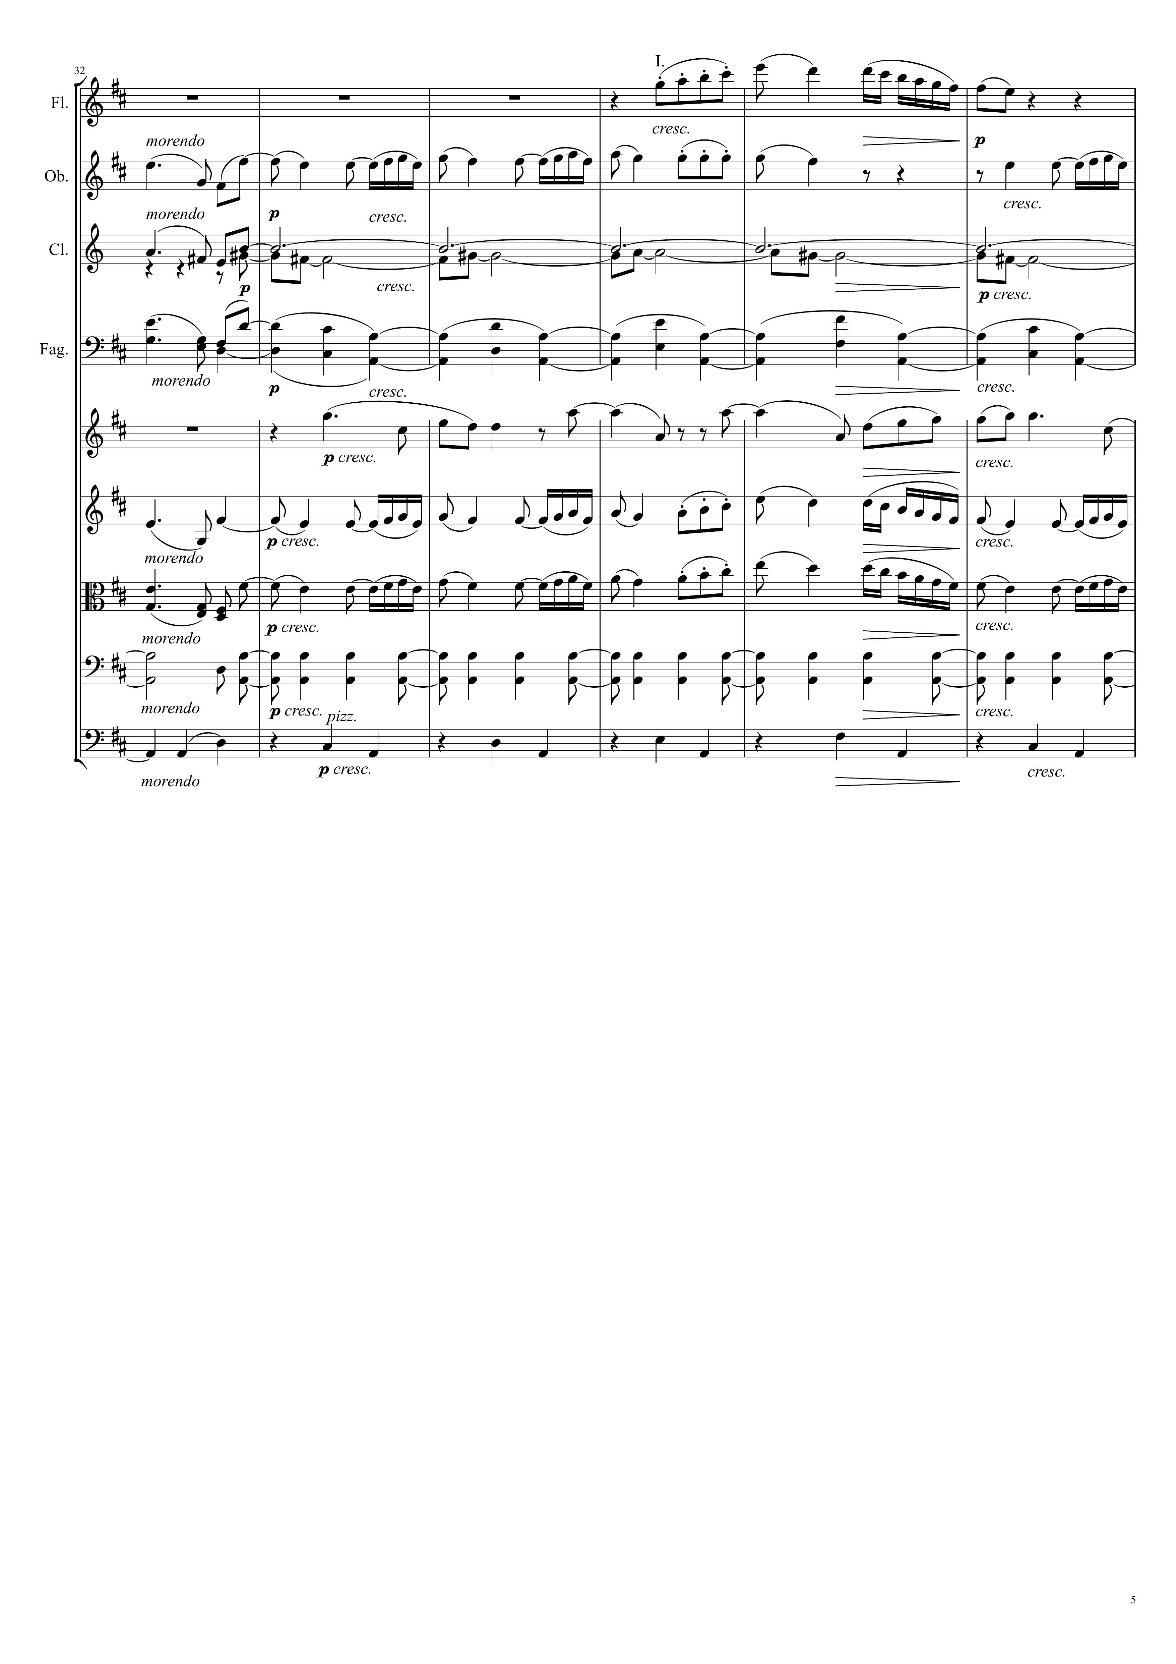
mel
mel
harm
mel
harm
harm
harm
mel
mel
harm
harm

Slide 6
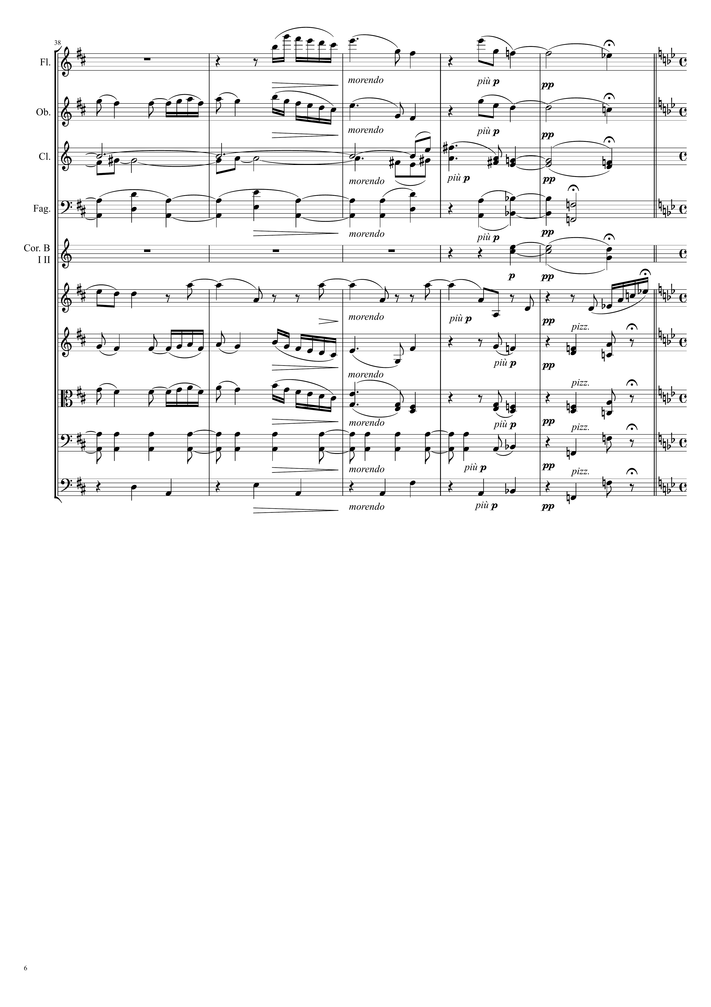
mel
harm
mel
harm
harm
mel
harm
harm
harm
mel
mel
harm
mel
harm
harm
harm

Slide 7
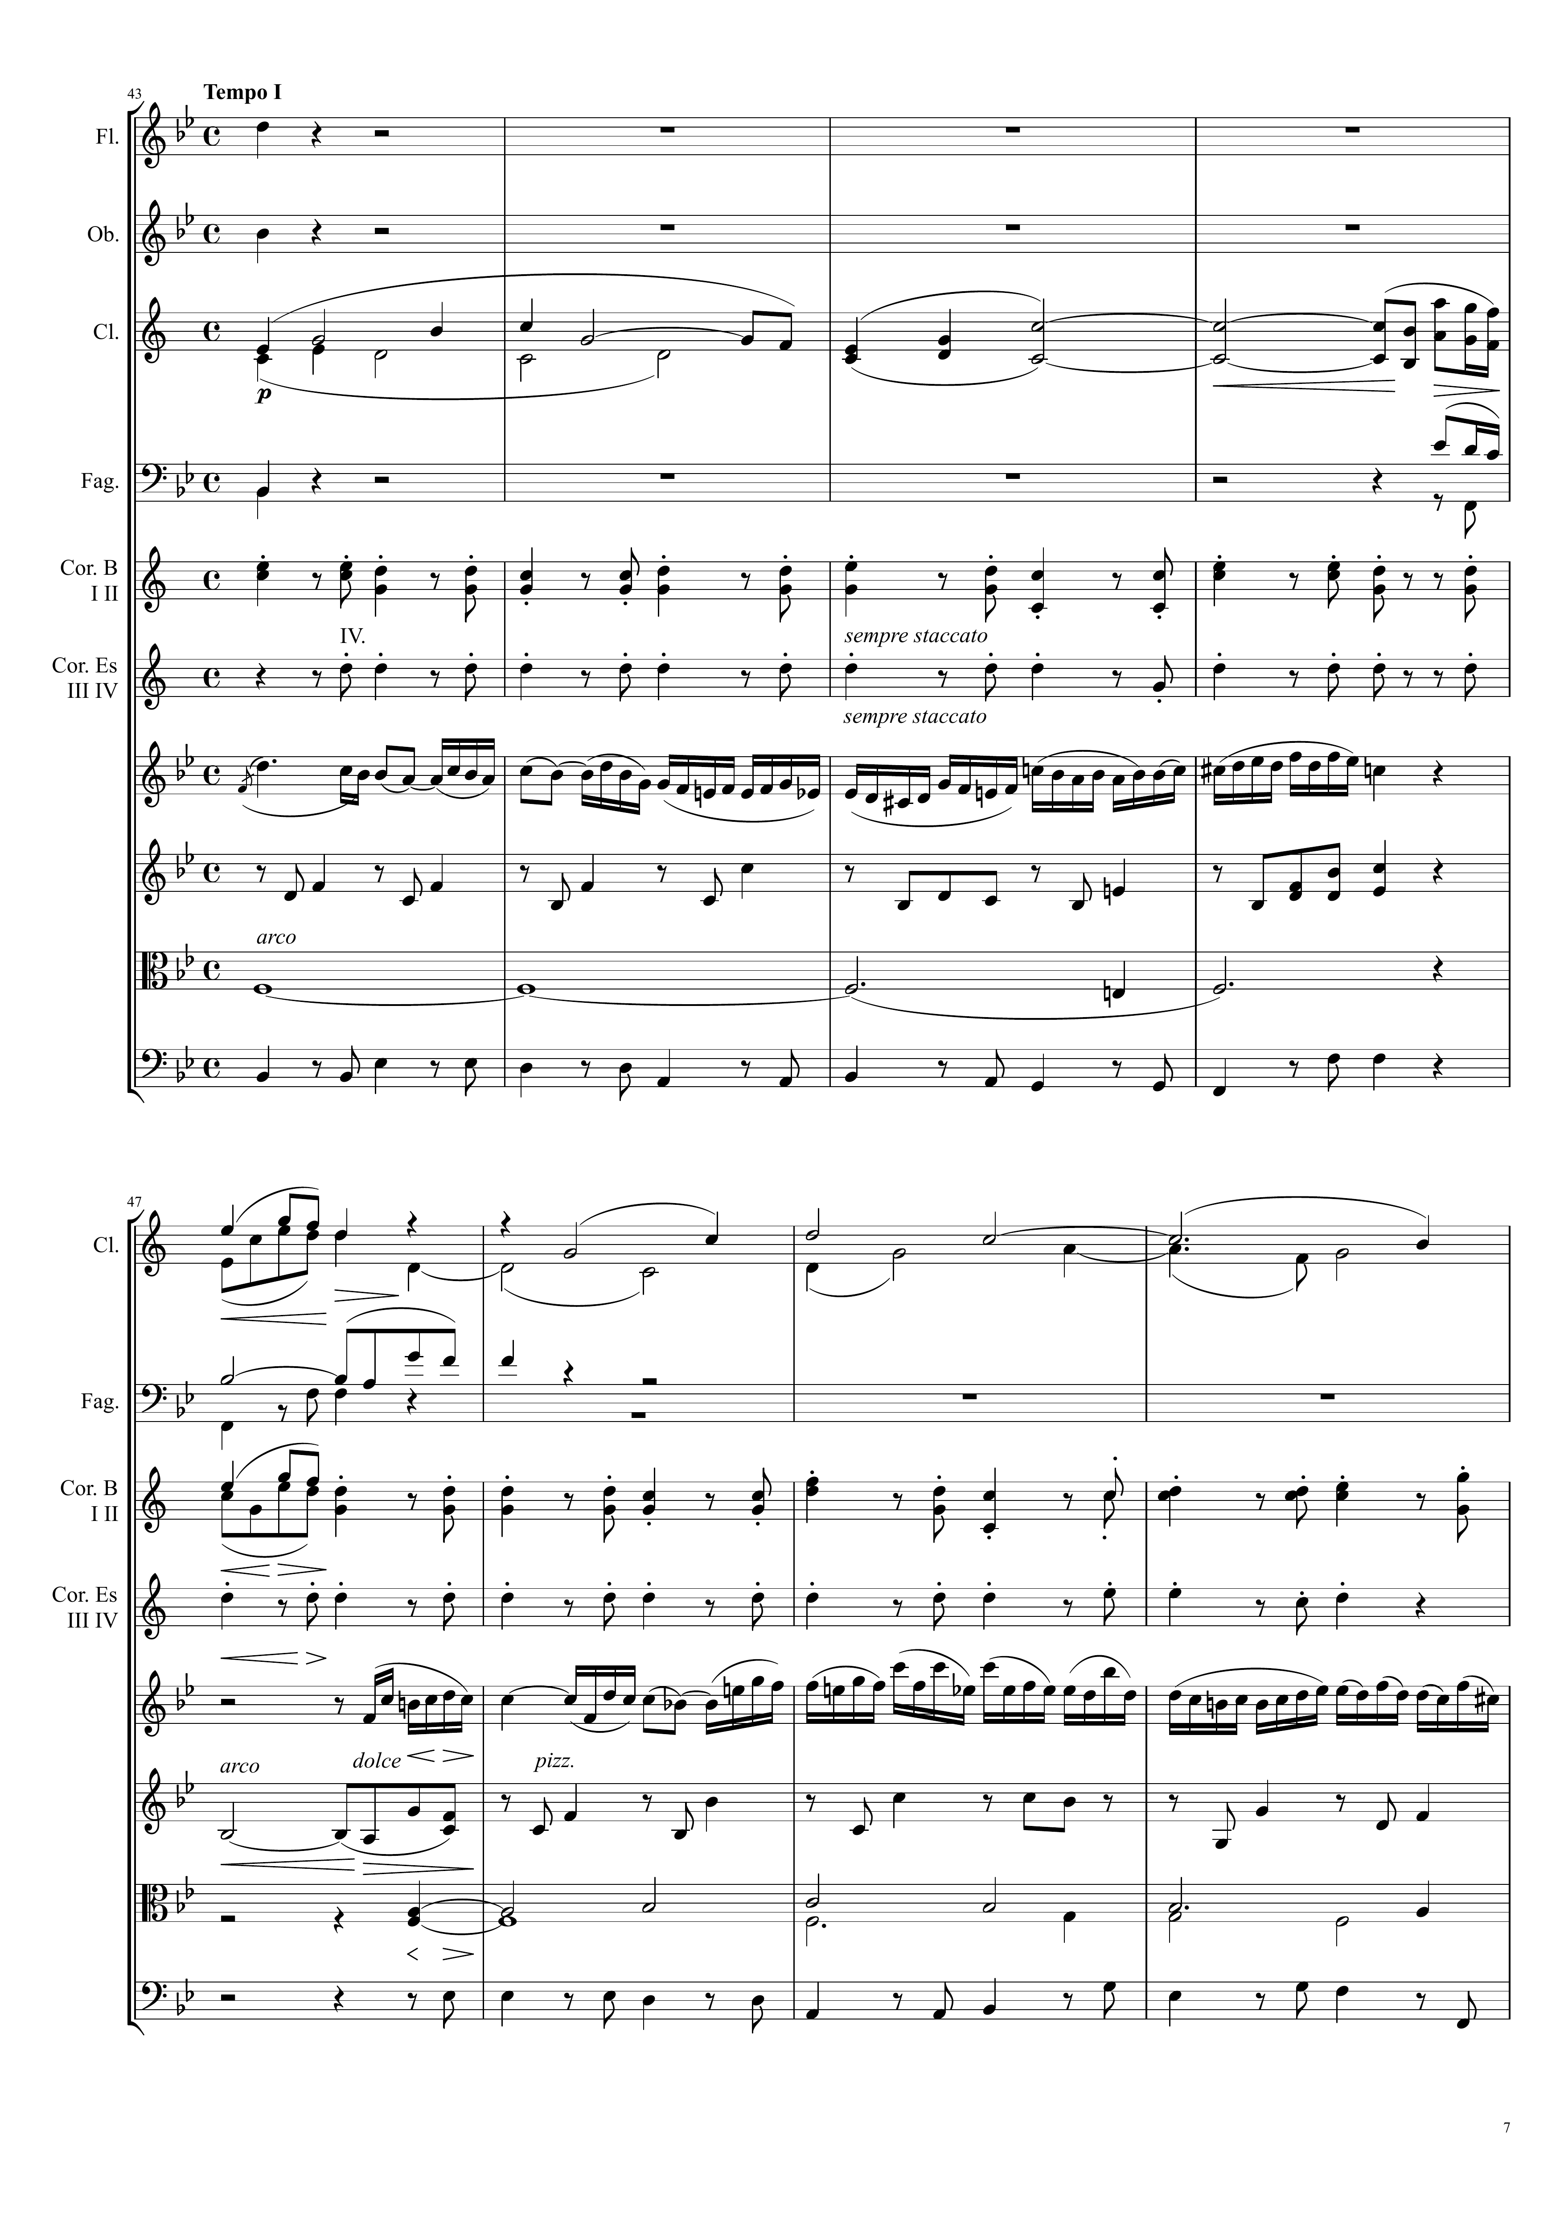
mel
Ｘ
mel
Ｘ
harm
mel
Ｘ
harm
harm
harm
harm
mel
Ｘ
harm
harm
harm
mel
Ｘ
harm
harm
harm
mel
Ｘ
harm
harm
harm
mel
Ｘ
harm
harm
harm

Slide 8
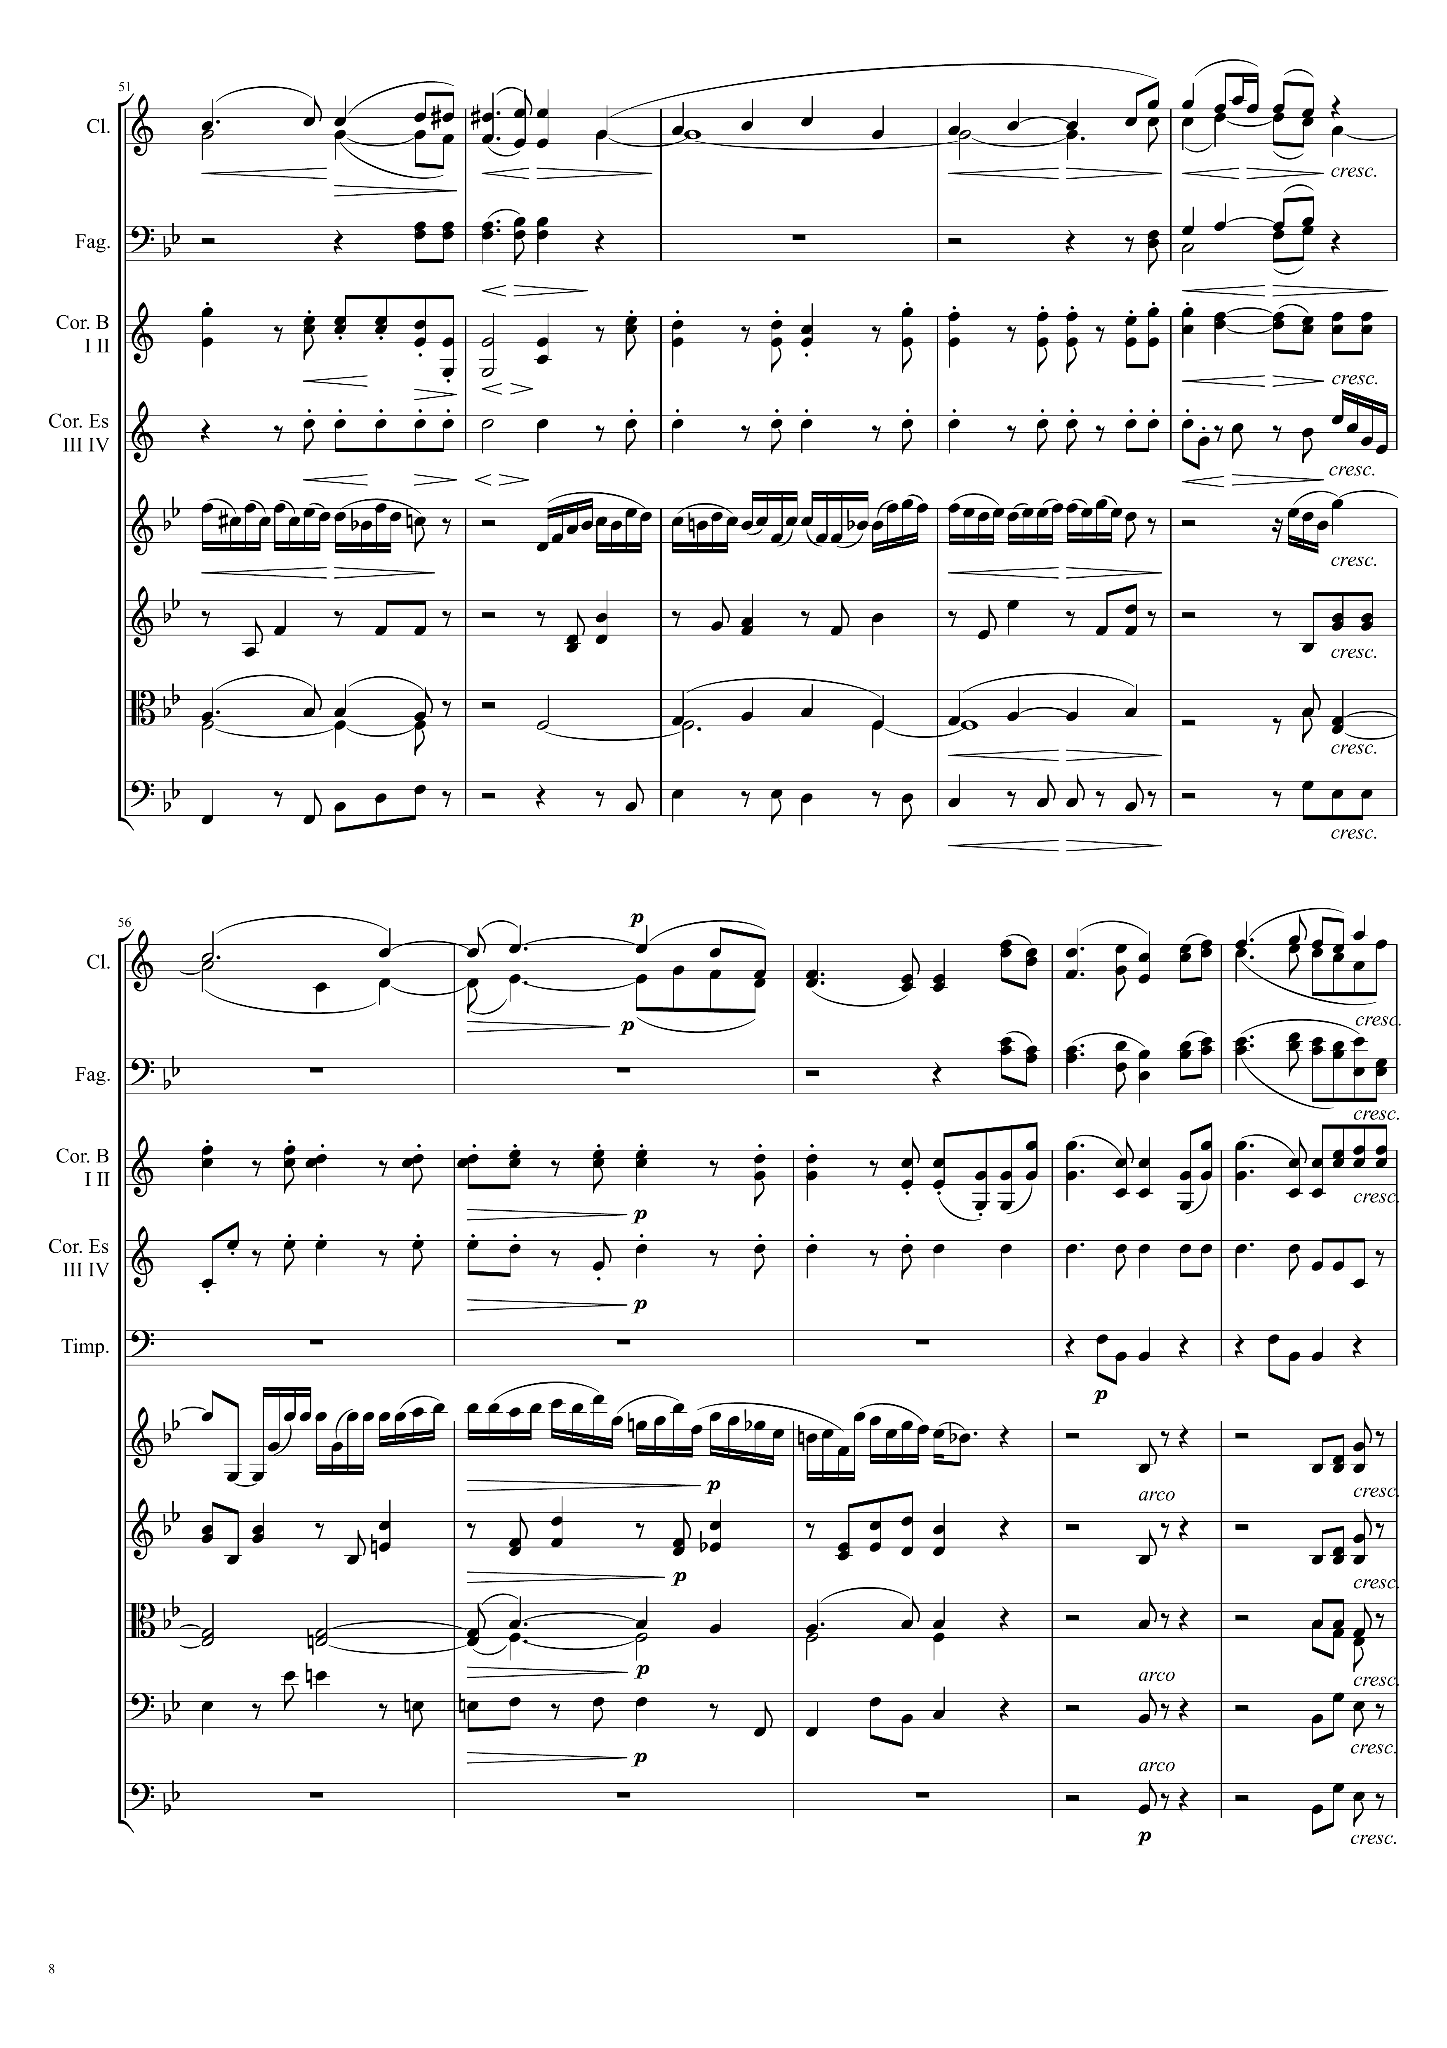
harm
mel
Ｘ
harm
mel
Ｘ
harm
harm
harm
harm
mel
Ｘ
mel
Ｘ
mel
Ｘ
mel
Ｘ
harm
harm
harm
harm
harm
harm
mel+harm
mel
Ｘ
mel
Ｘ
harm
harm
harm
mel
Ｘ
harm
harm
harm
harm
harm
harm
harm
harm

Slide 9
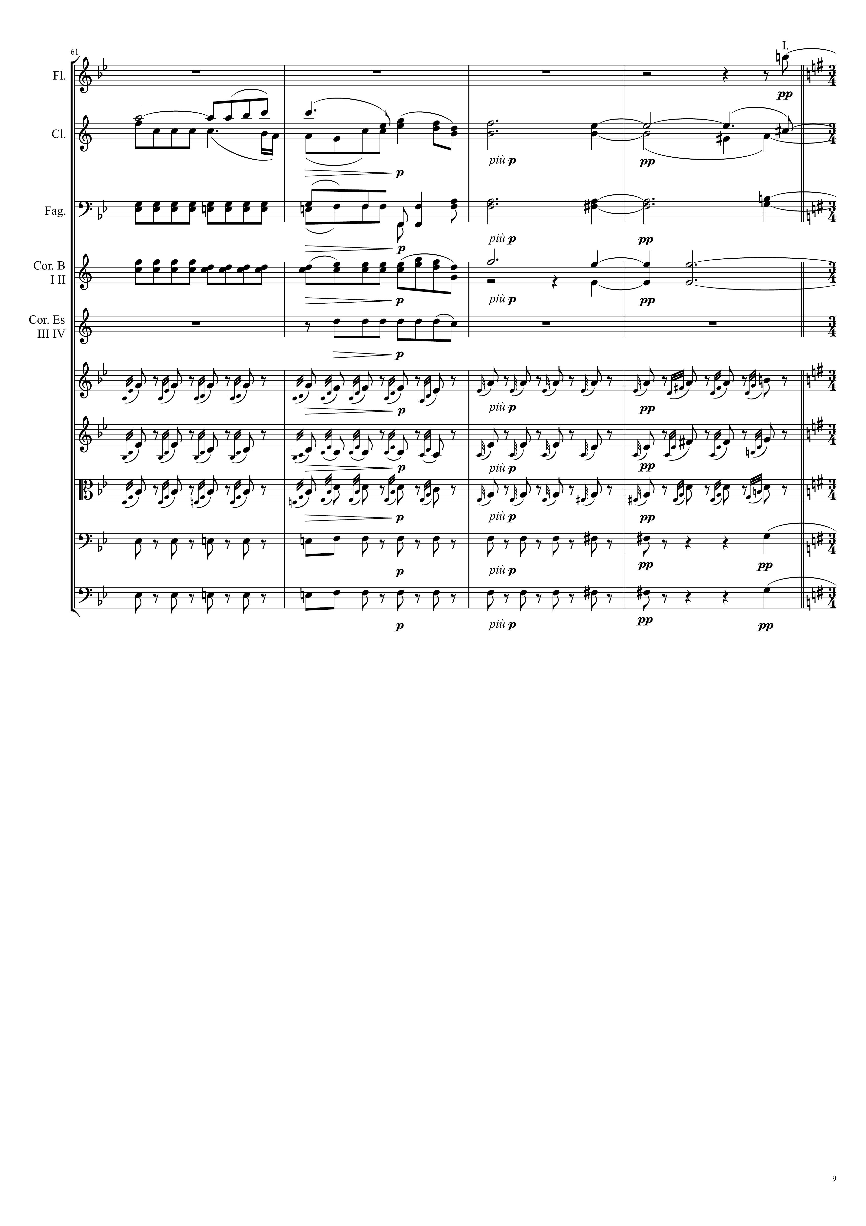
mel
Ｘ
mel+harm
mel
Ｘ
harm
交錯當mel harm
harm
mel
Ｘ
harm
harm
harm
harm
harm
harm
harm
harm

Slide 10
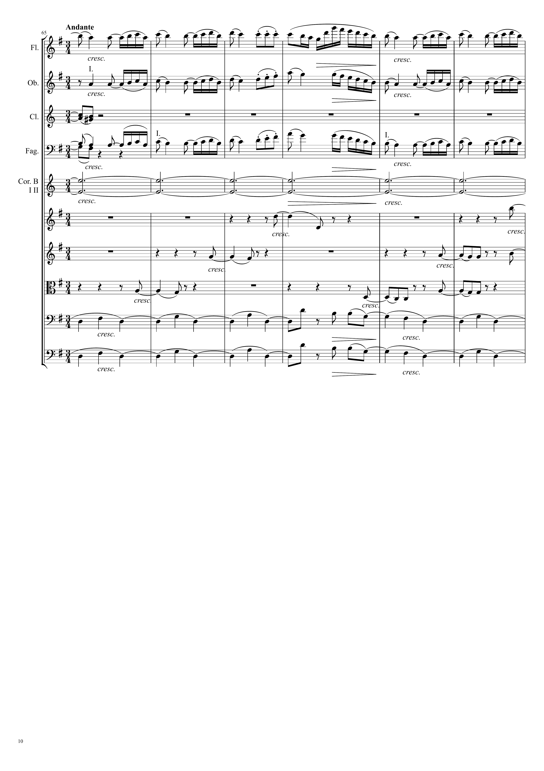
mel
Ｘ
mel
Ｘ
harm
mel
Ｘ
harm
mel+harm
mel+harm
mel+harm
harm
harm

Slide 11
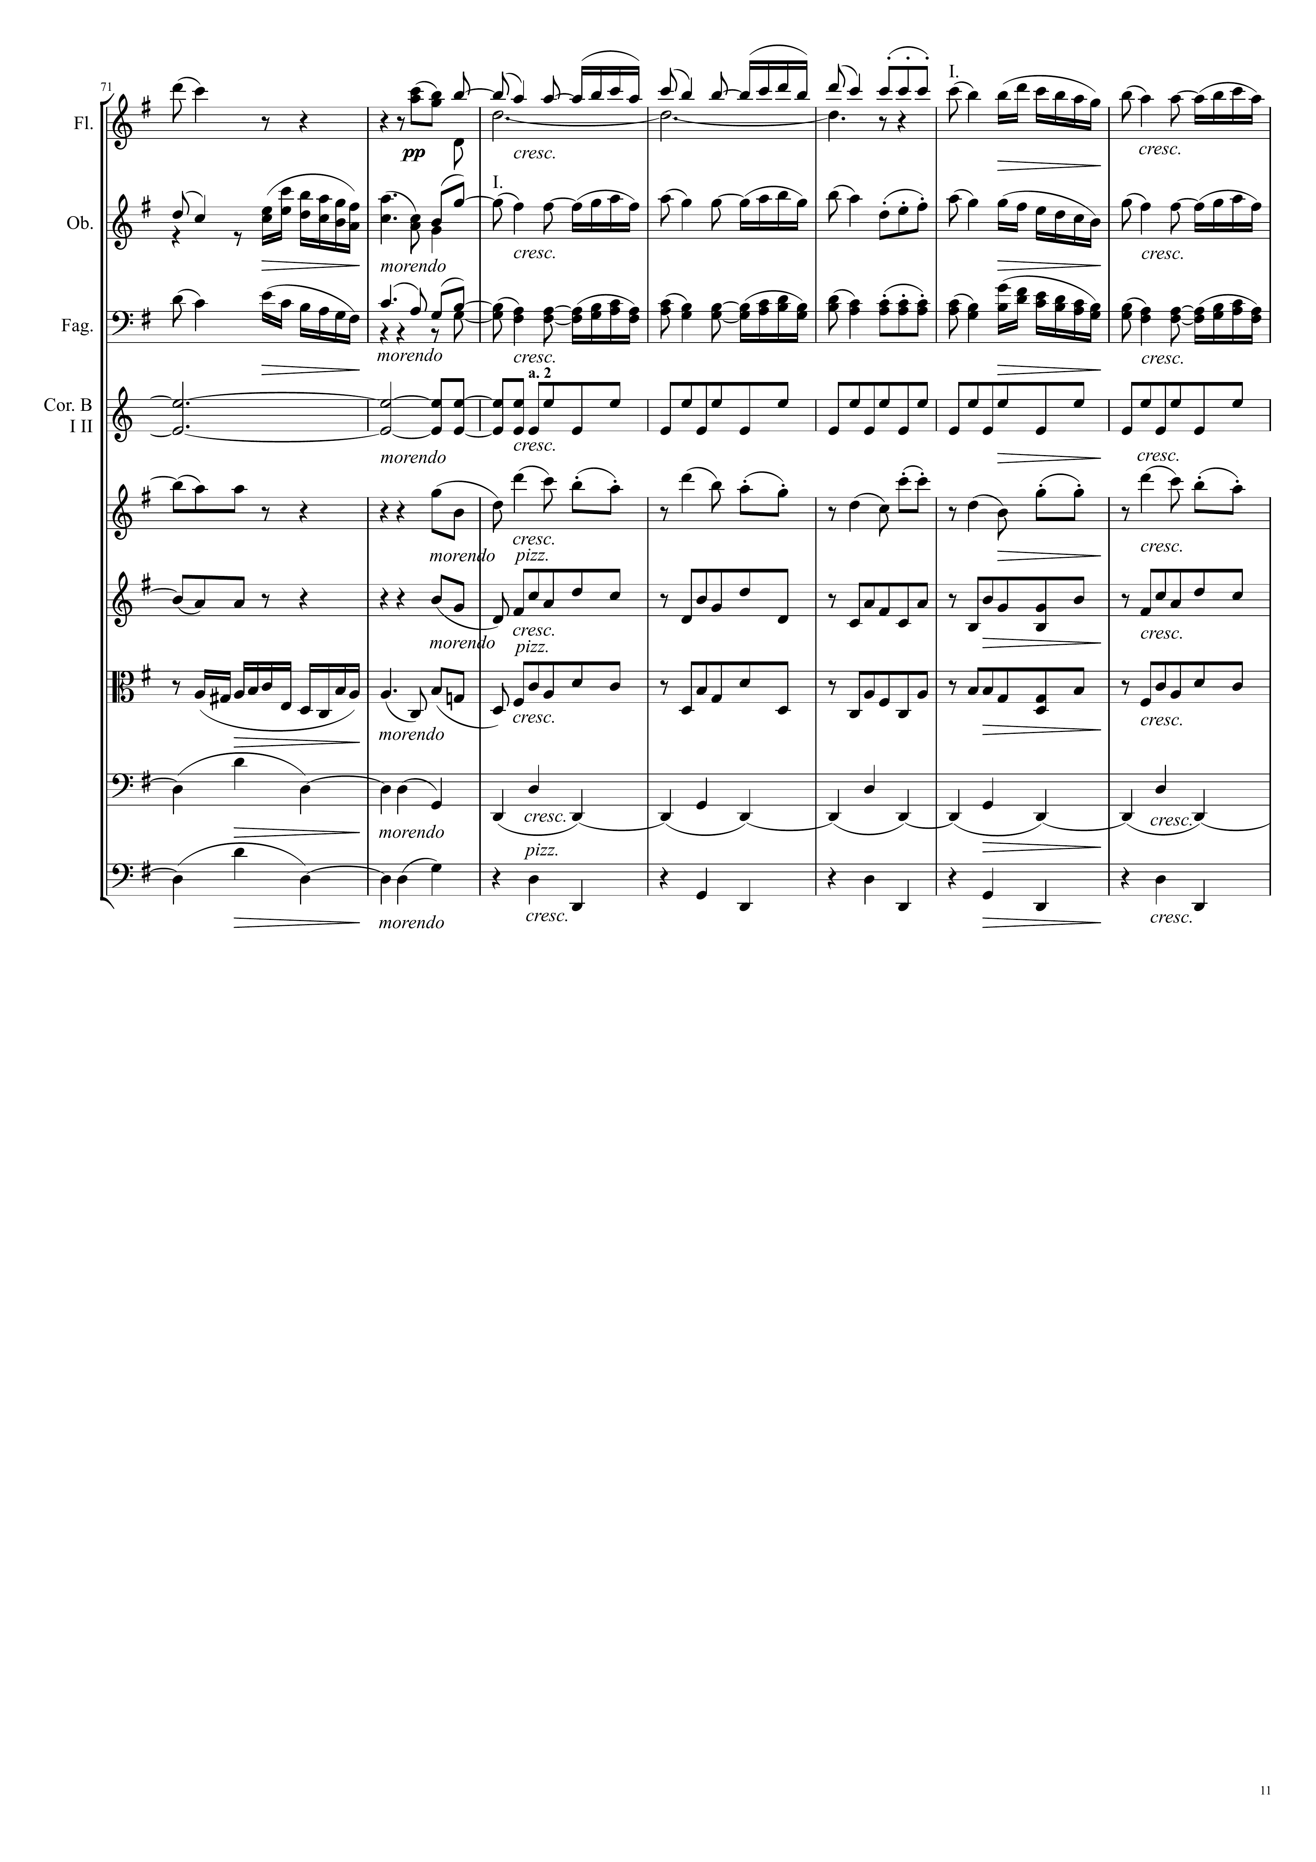
mel
Ｘ
mel
Ｘ
mel
Ｘ
harm
mel+harm
mel+harm
harm
harm
harm
harm

Slide 12
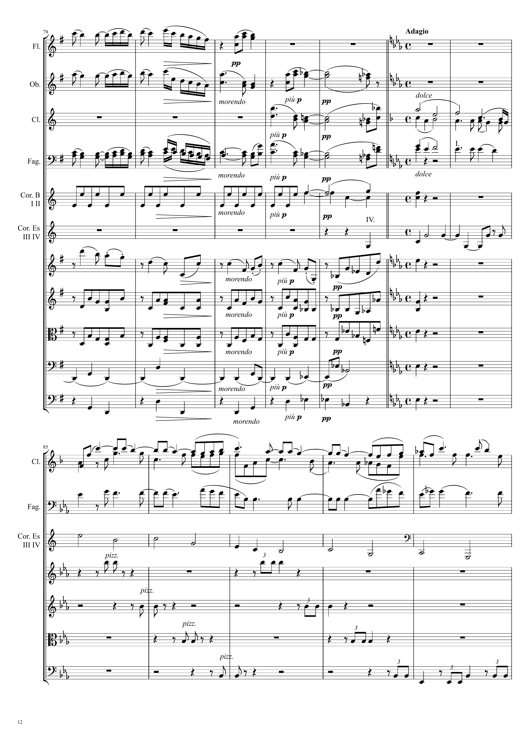
mel
Ｘ
mel
Ｘ
mel
Ｘ
mel+harm
mel
Ｘ
harm
harm
harm
harm
harm
mel+harm
mel
Ｘ
harm
harm
harm
harm
harm
harm
harm
harm
mel+harm
harm
mel
Ｘ
harm
harm
harm
harm
harm
harm

Slide 13
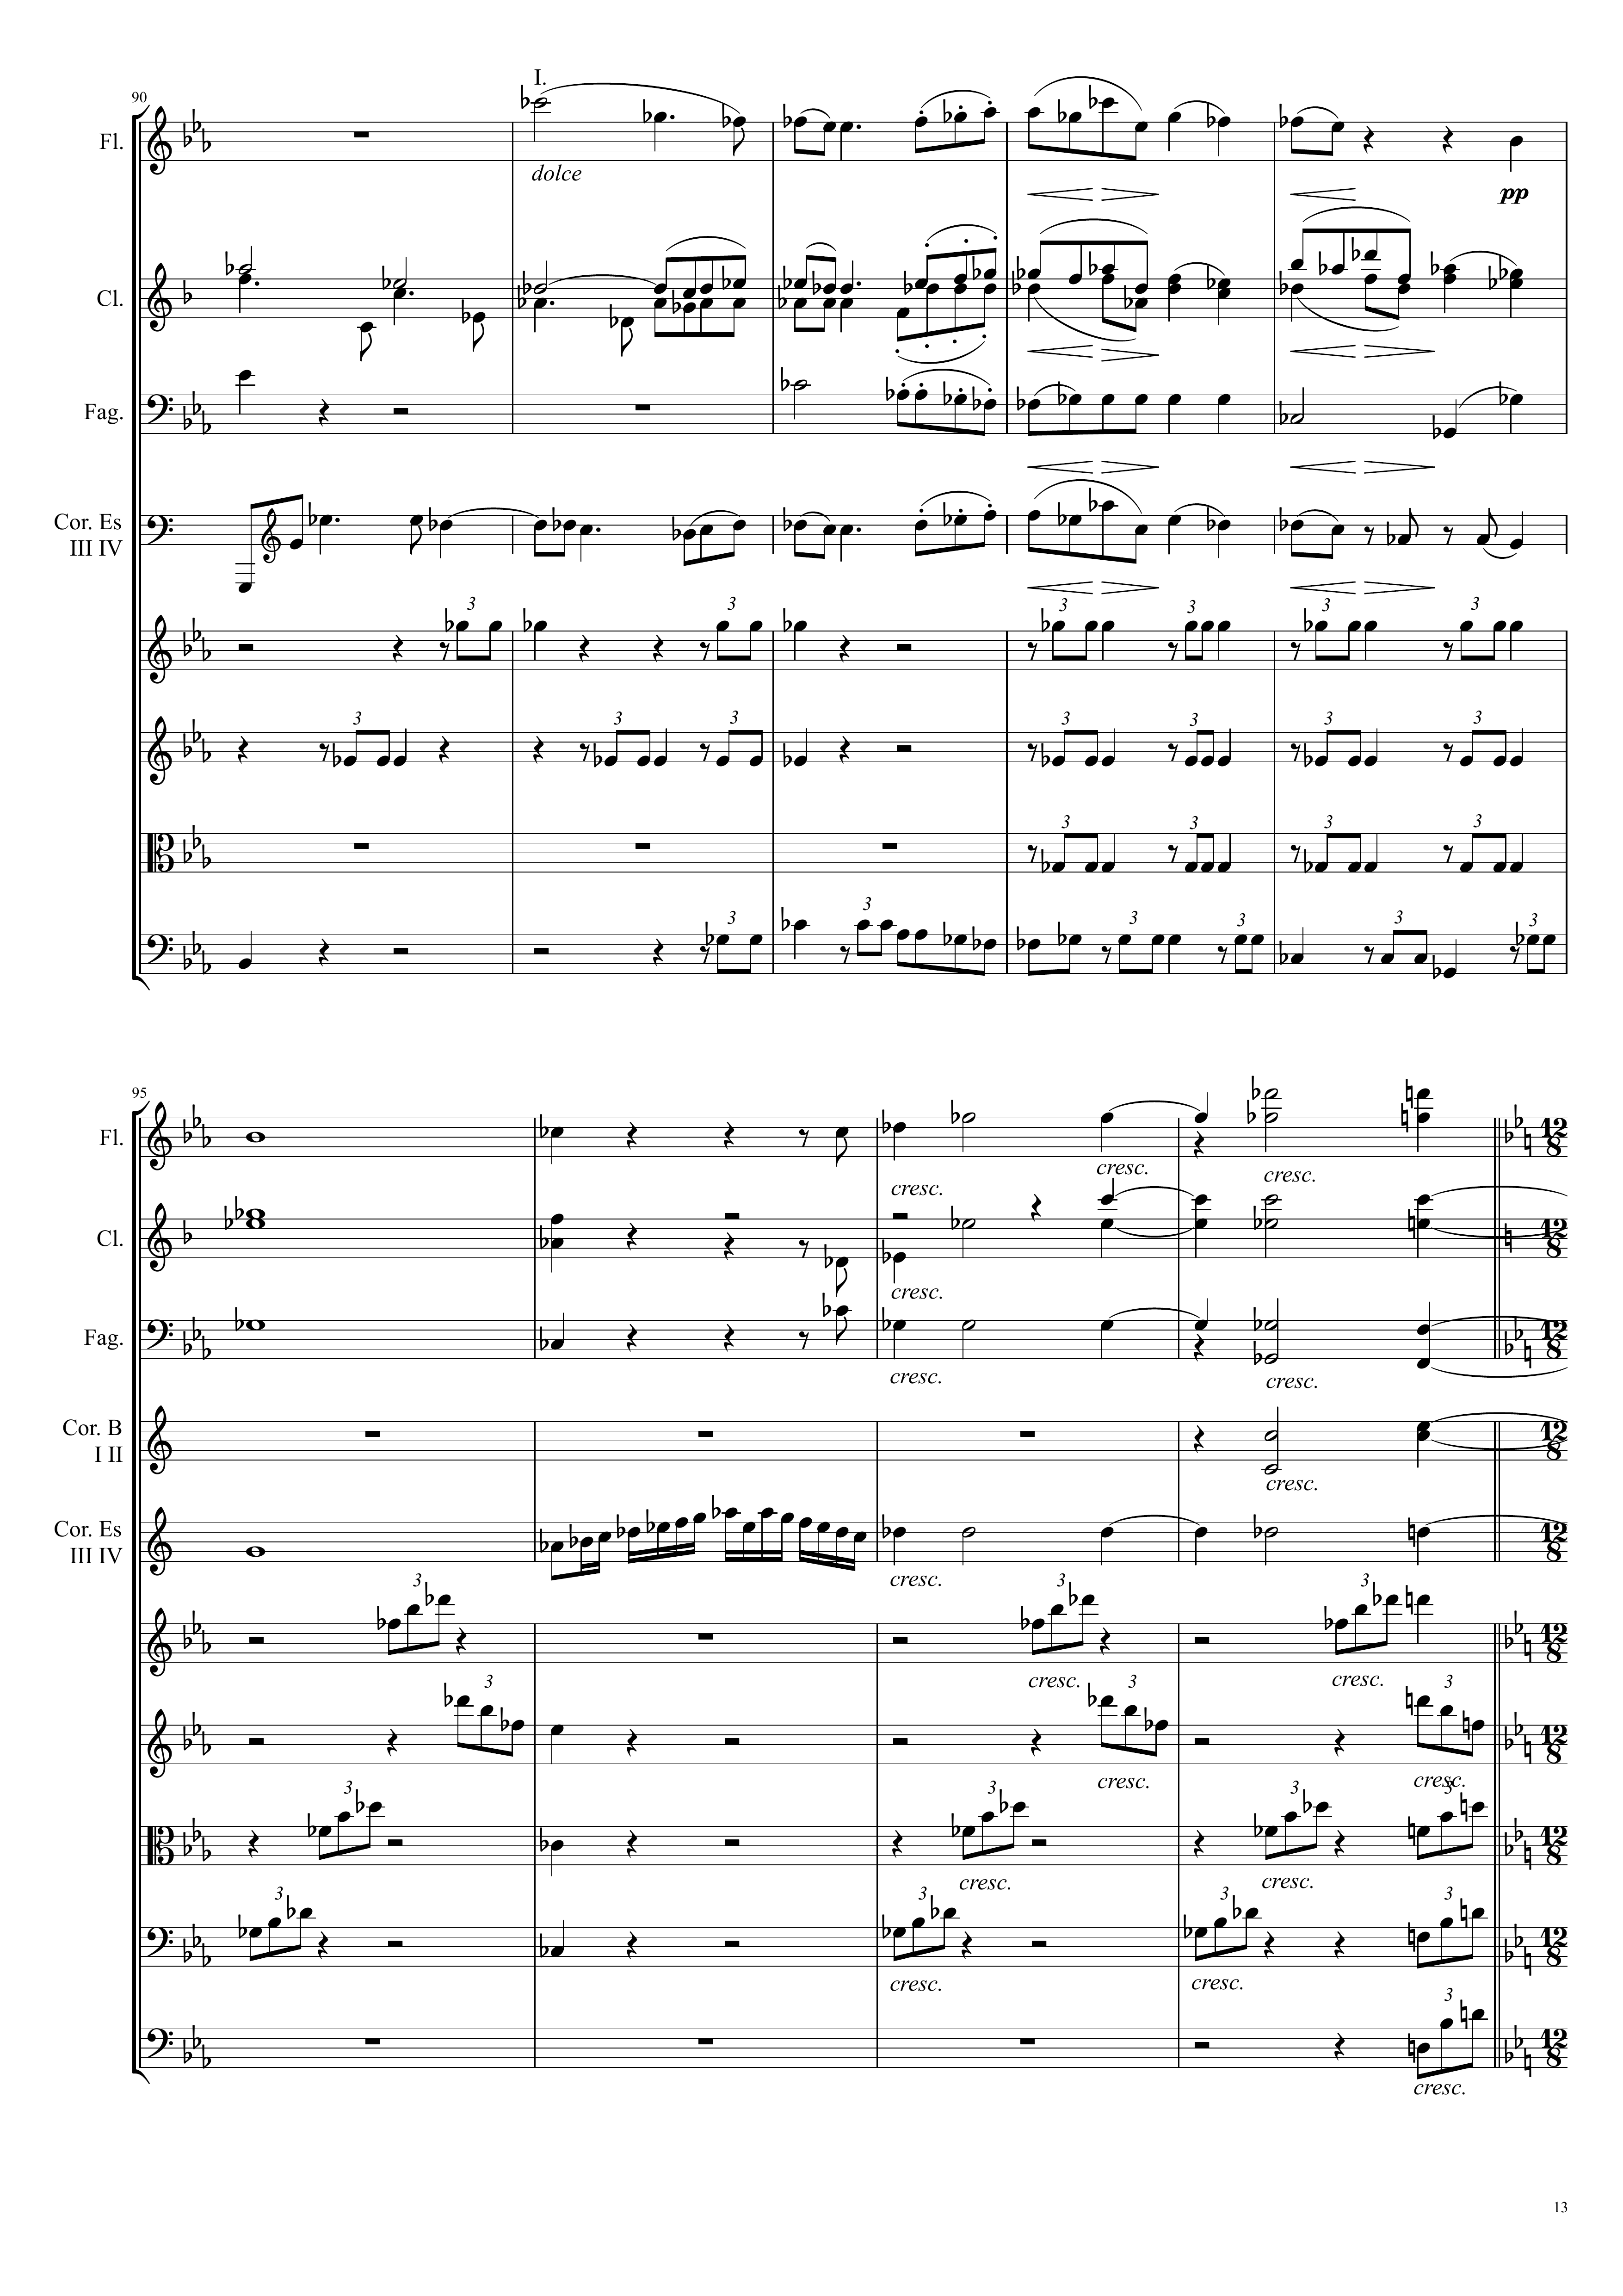
mel
Ｘ
mel+harm
harm
harm
harm
mel
Ｘ
harm
harm
harm
harm
mel
Ｘ
harm
harm
harm
harm
harm
mel
Ｘ
harm
mel+harm
mel+harm
mel+harm
mel+harm
mel+harm

Slide 14
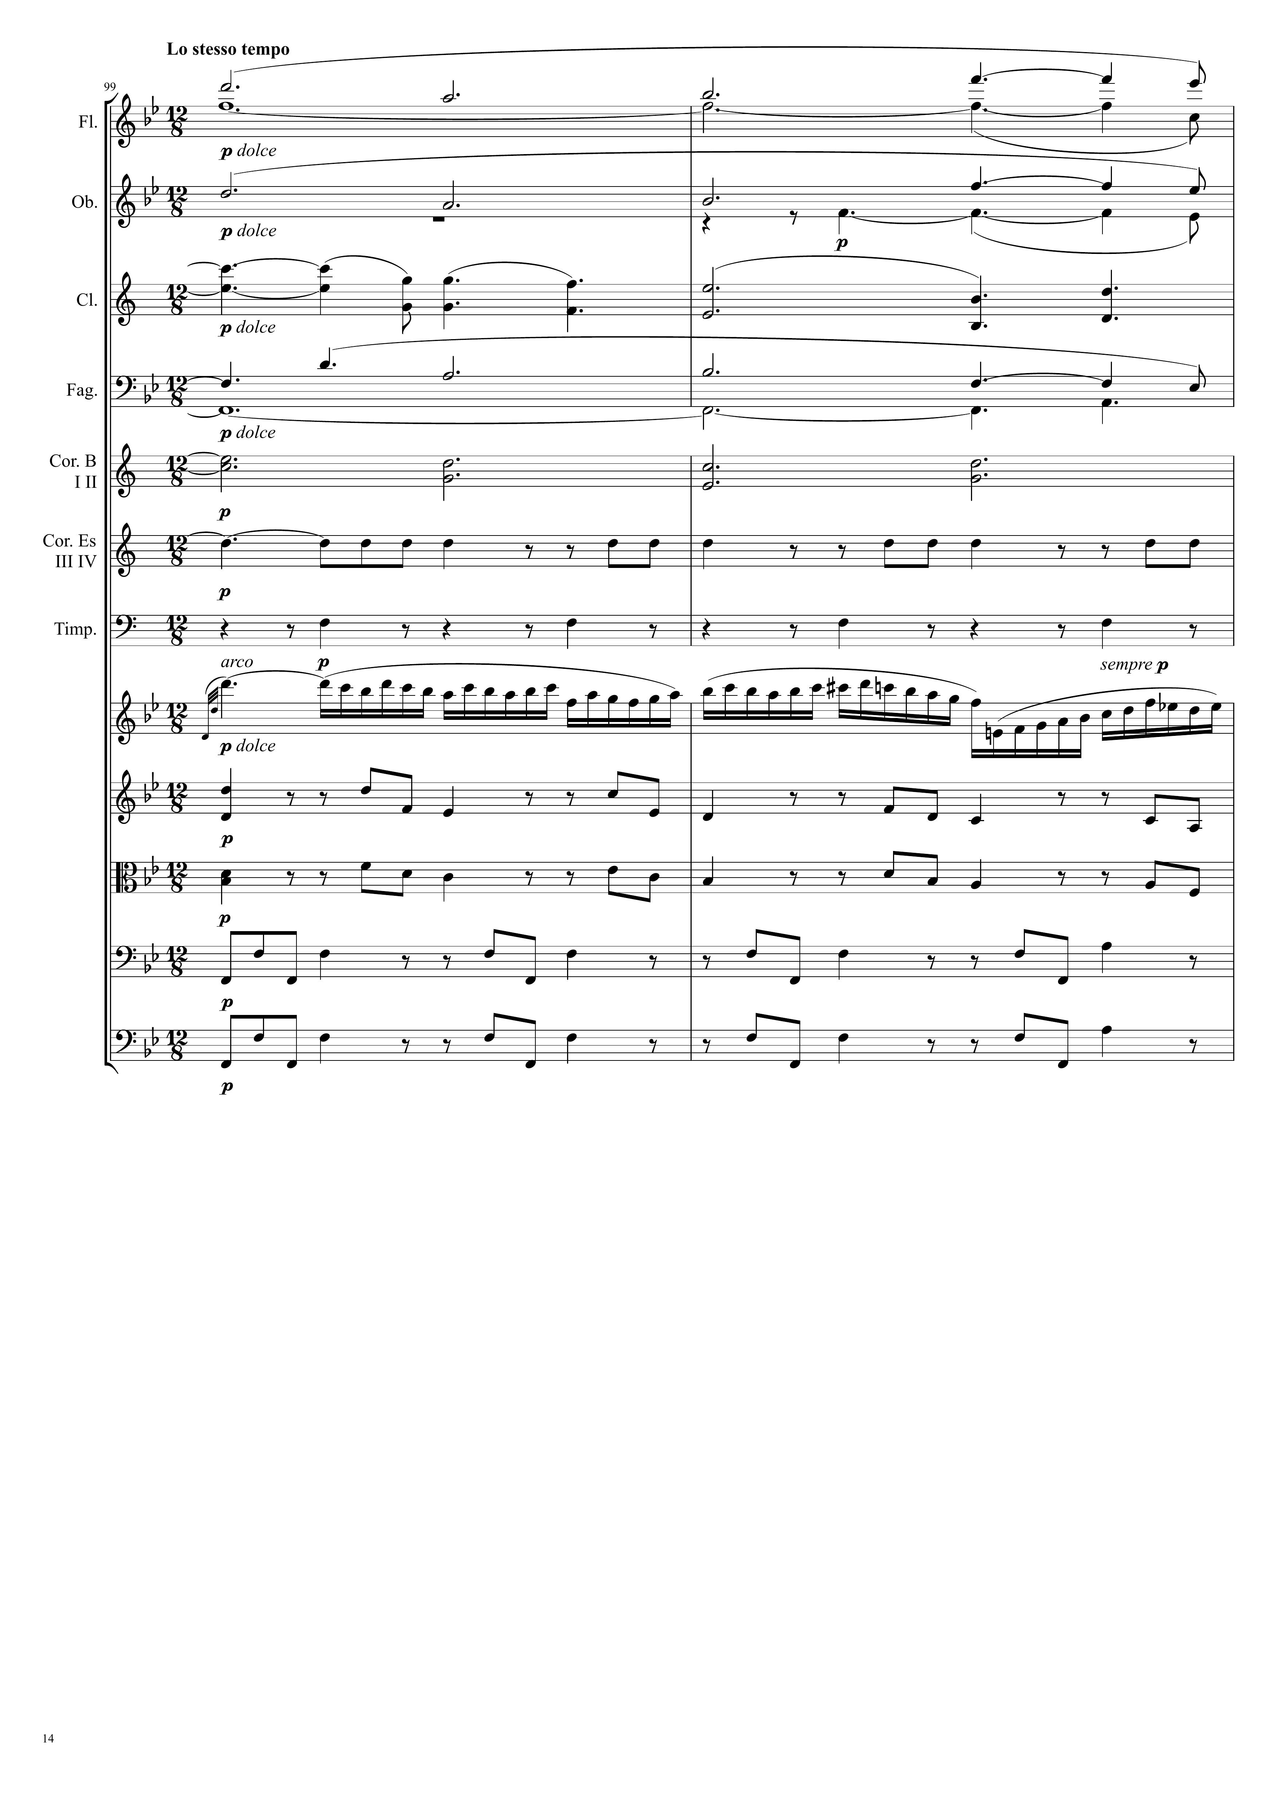
harm
harm
harm
harm
harm
harm
harm
mel
Ｘ
harm
harm
harm
harm

Slide 15
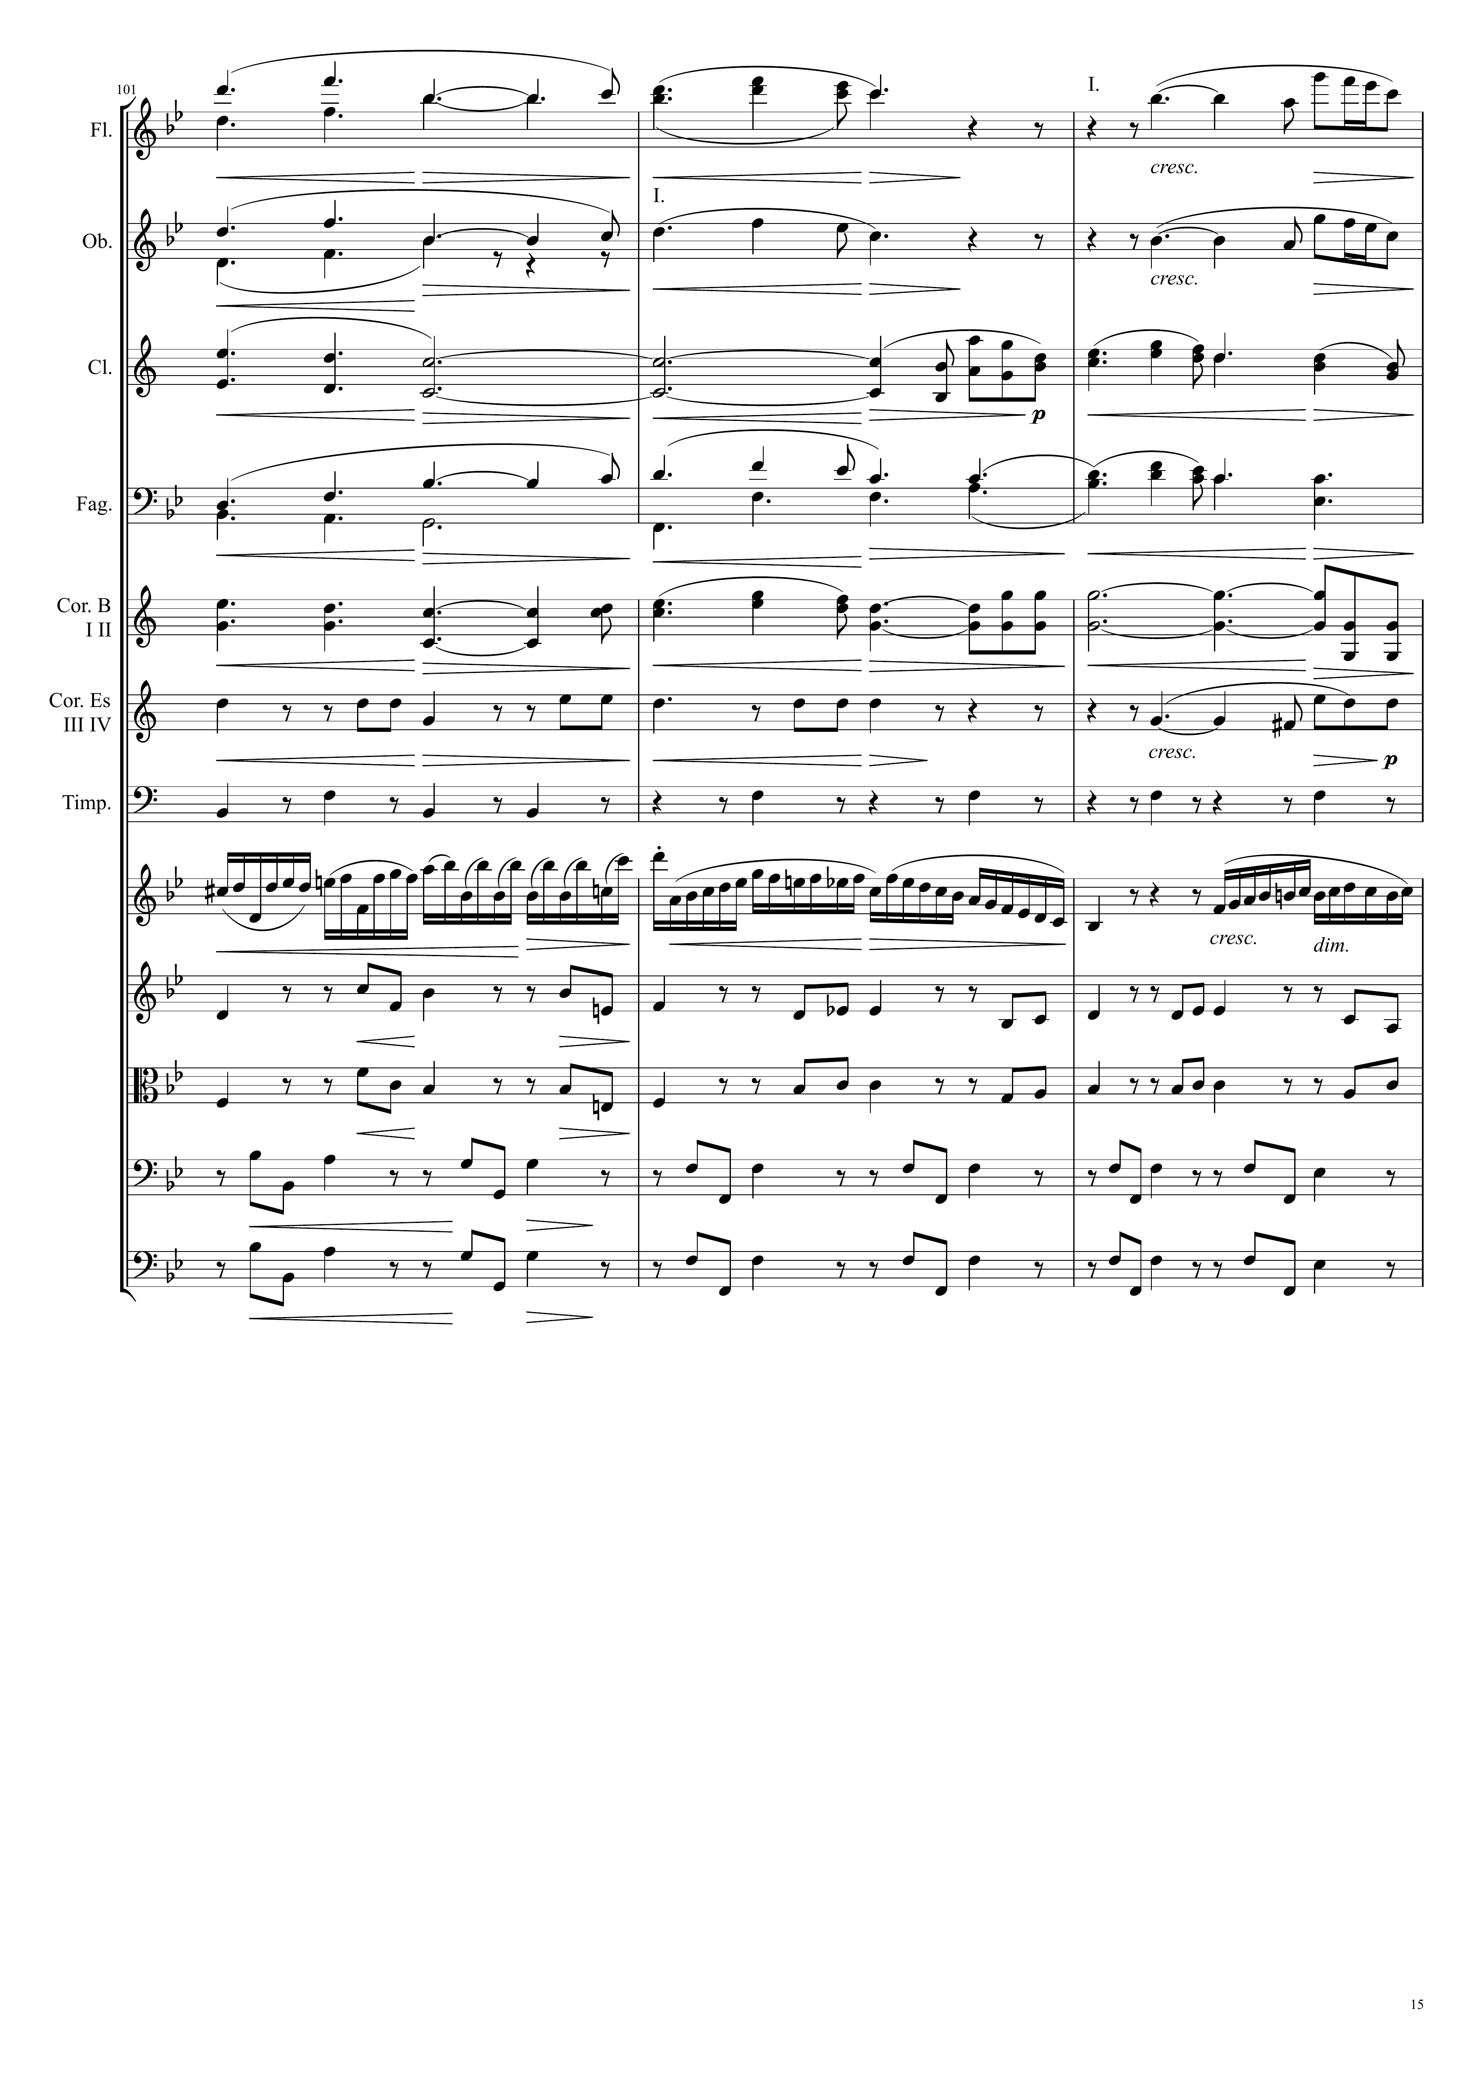
harm
mel+harm
harm
mel+harm
harm
mel+harm
harm
harm
harm
harm
harm
mel
Ｘ
harm
harm
harm
harm

Slide 16
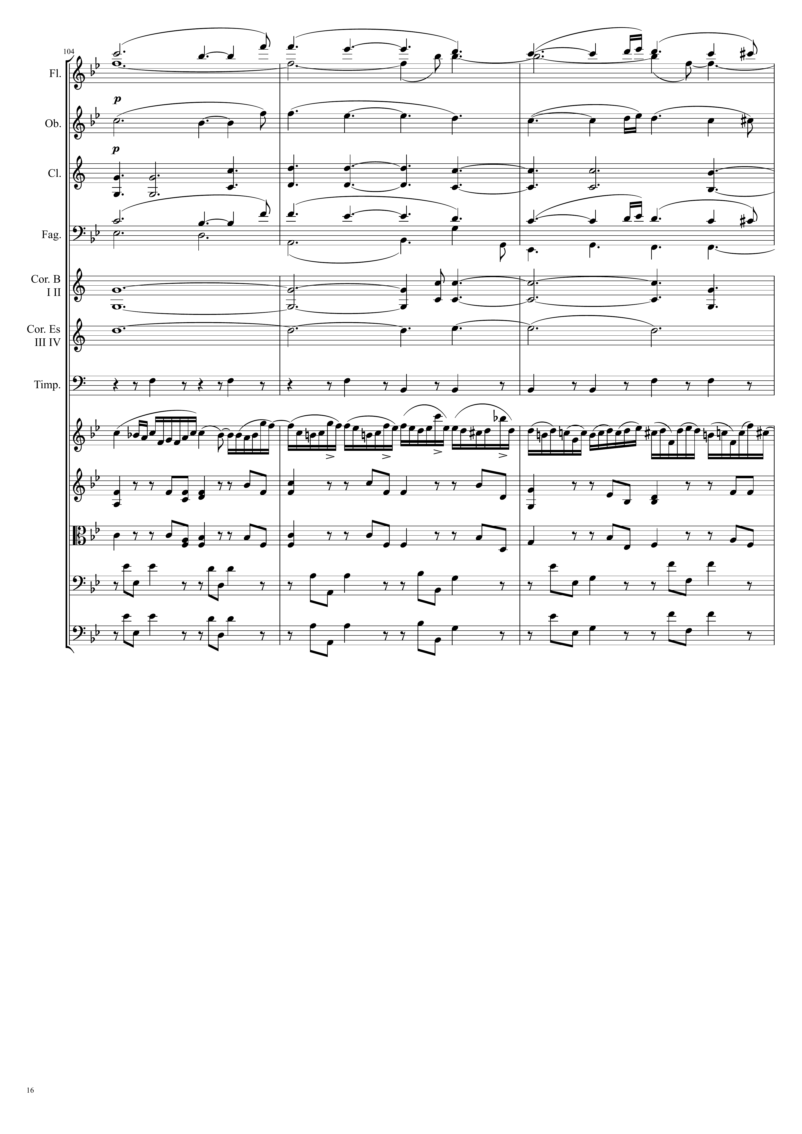
harm
harm
harm
harm
harm
harm
harm
mel
Ｘ
harm
harm
harm
harm

Slide 17
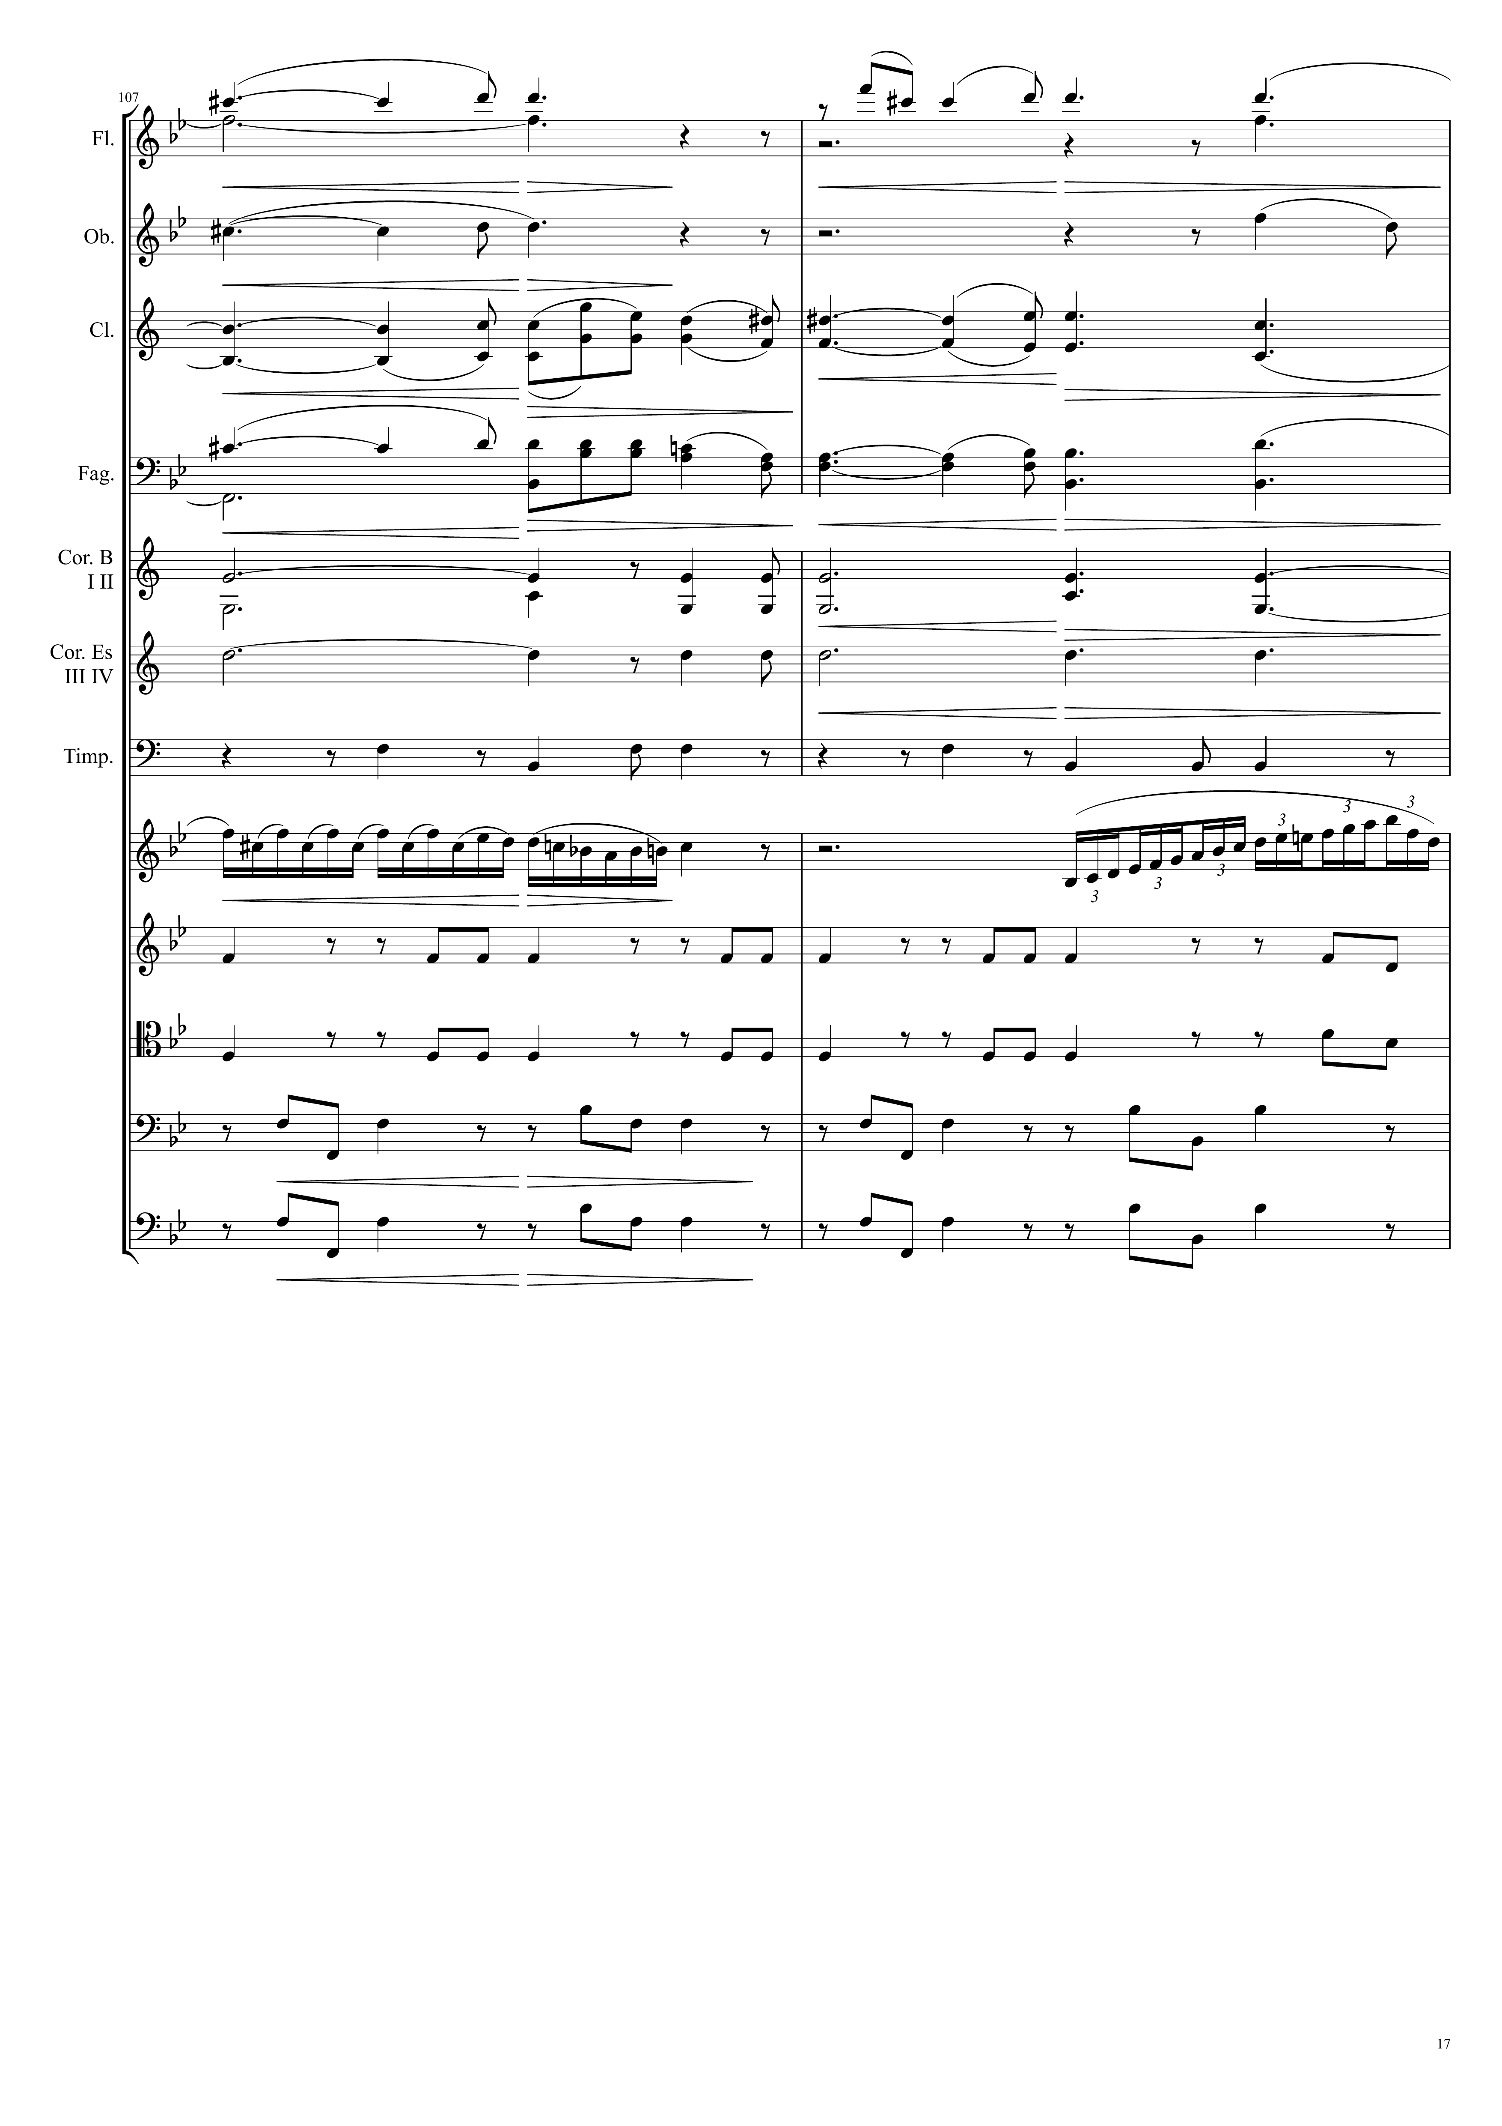
harm
mel
Ｘ
harm
harm
harm
mel+harm
harm
harm
harm
harm
harm
harm
mel
Ｘ
harm
harm
harm
harm

Slide 18
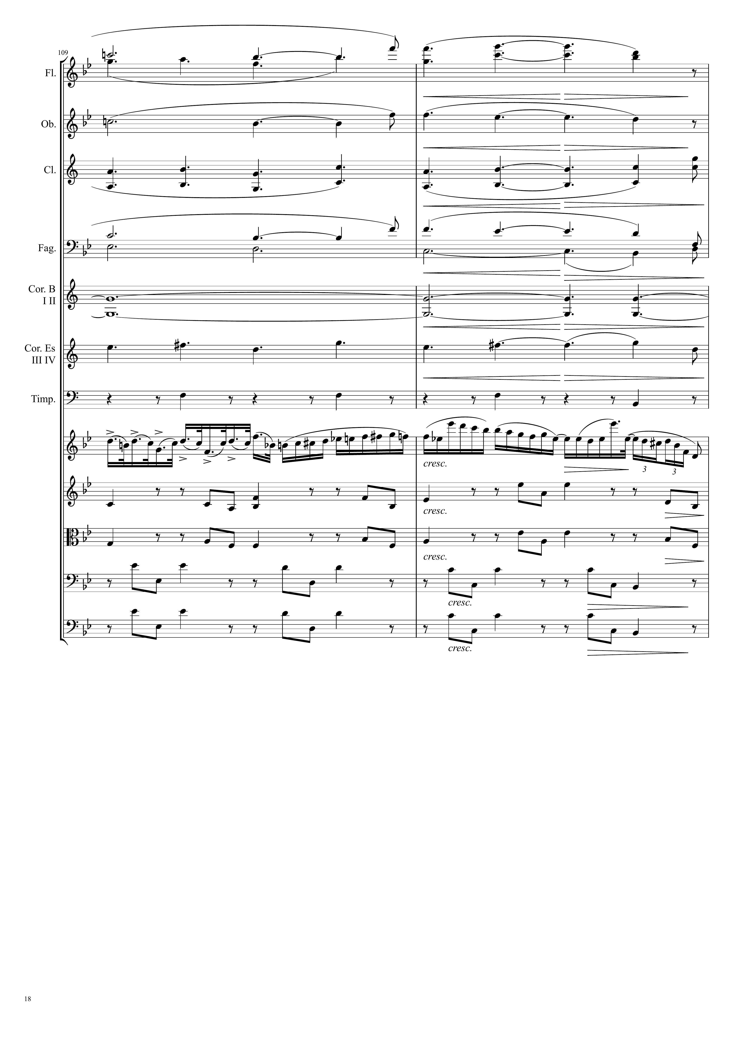
harm
harm
harm
mel
Ｘ
harm
harm
harm
harm
mel
Ｘ
harm
harm
harm
harm

Slide 19
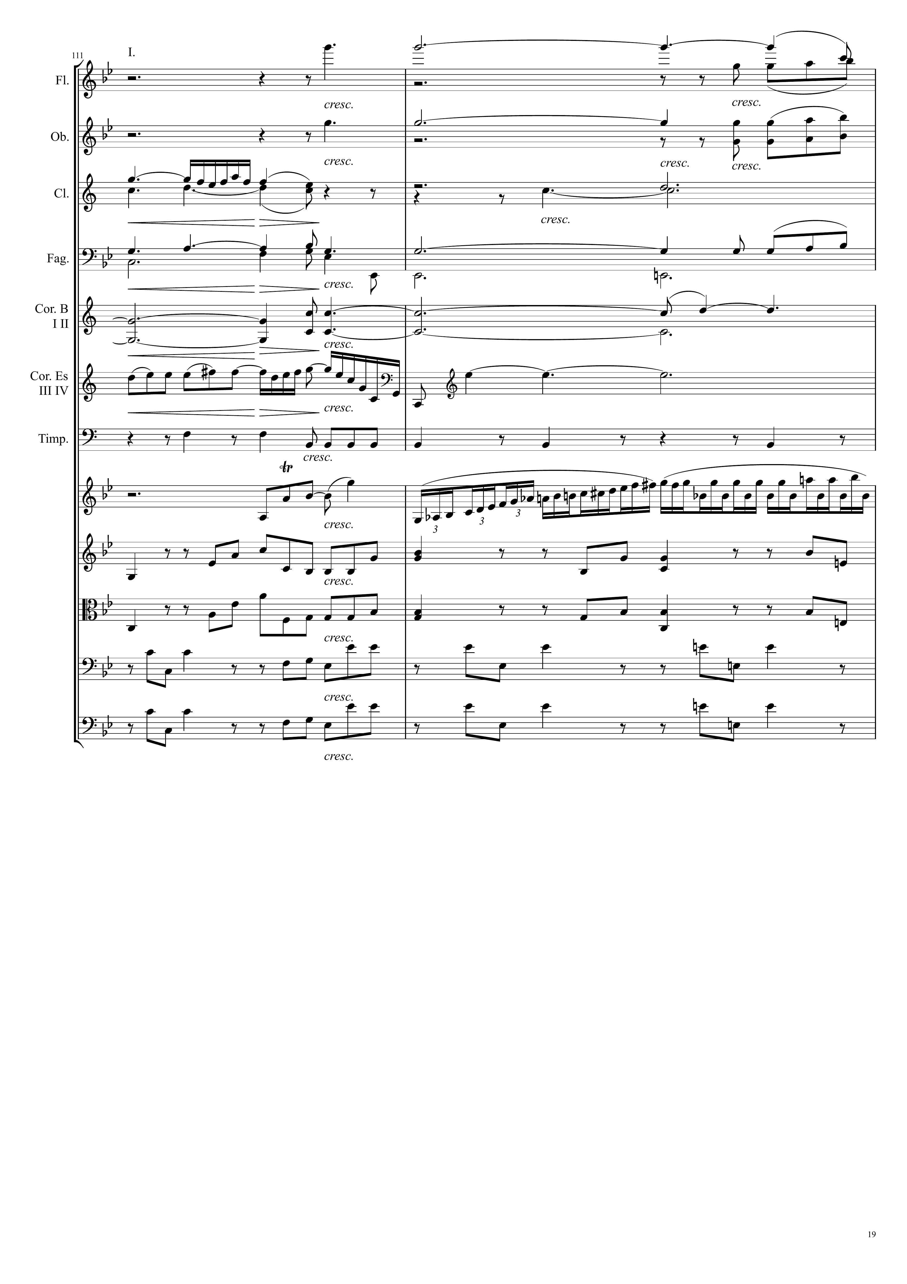
harm
harm
mel
Ｘ
harm
harm
harm
mel
Ｘ
harm
harm
harm
mel
Ｘ
harm
harm
harm
harm

Slide 20
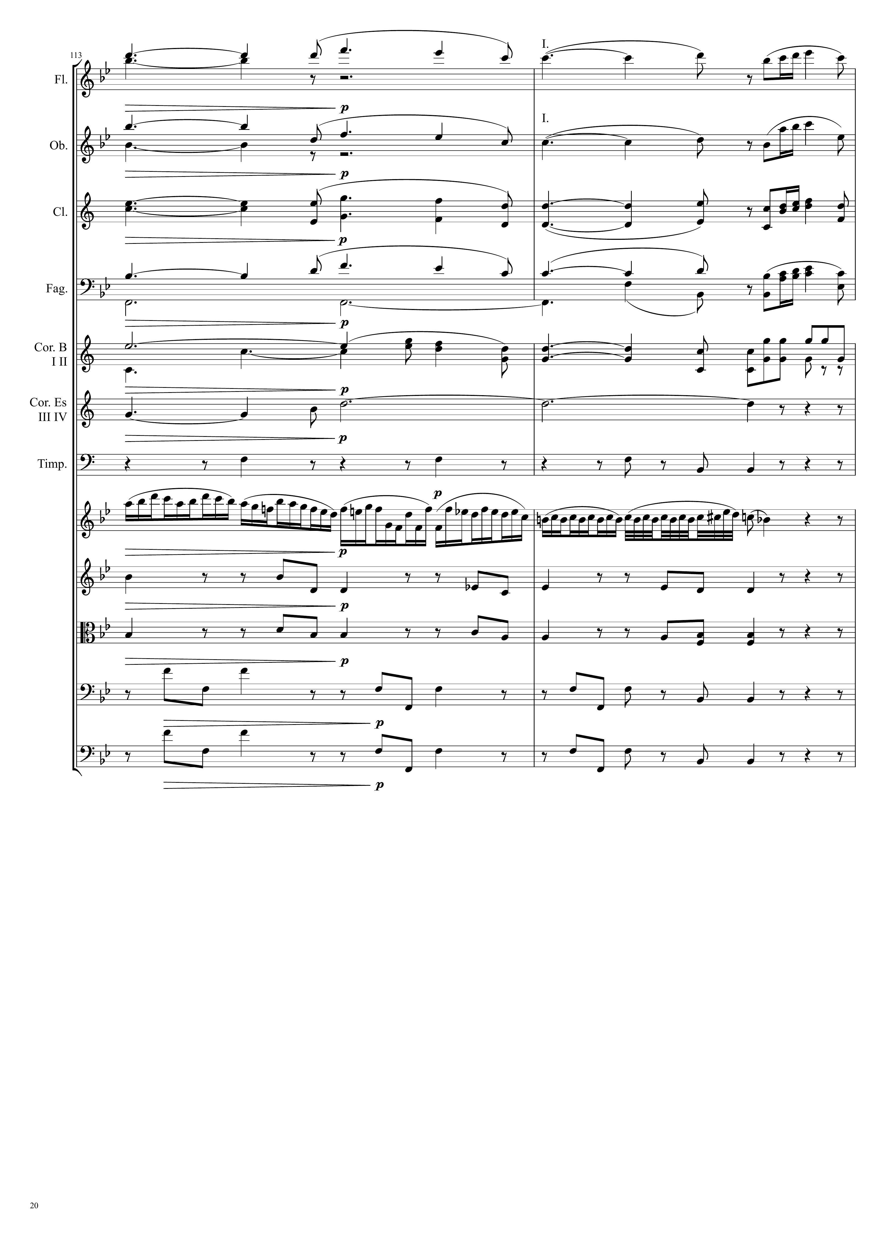
harm
mel
Ｘ
harm
mel
Ｘ
harm
mel
Ｘ
harm
harm
mel
Ｘ
harm
harm
harm
harm
mel
Ｘ
harm
harm
harm
harm

Slide 21
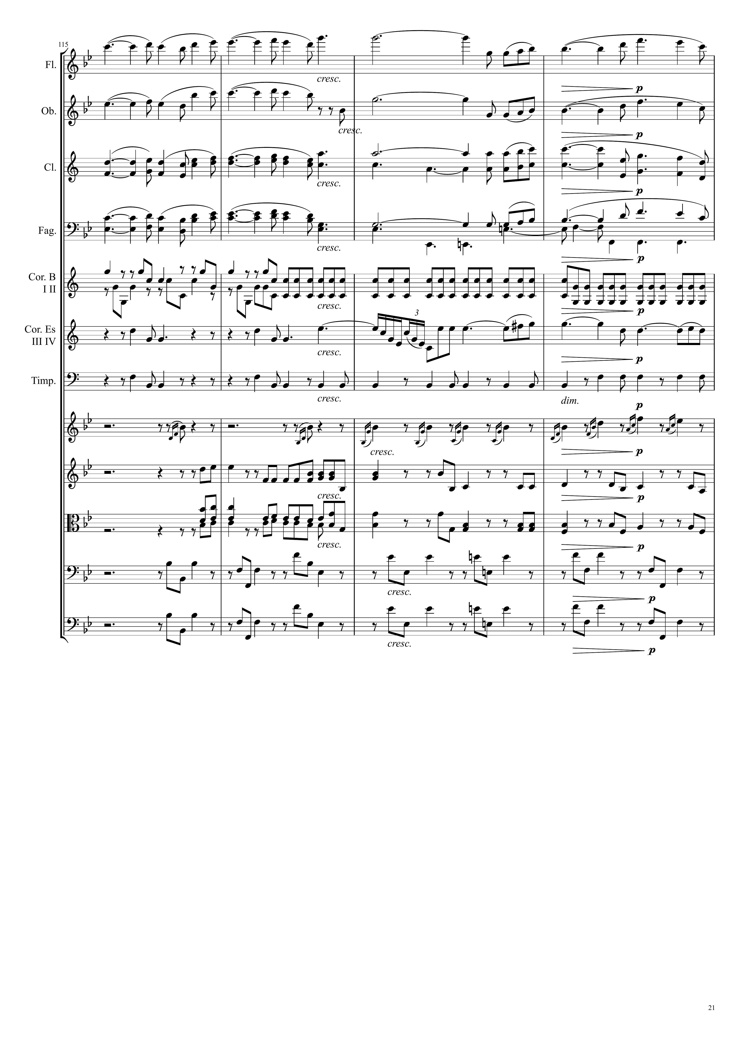
mel
Ｘ
mel
Ｘ
mel
Ｘ
mel
Ｘ
harm
mel
Ｘ
harm
harm
v
harm
mel
Ｘ
harm
v
harm
harm
harm
harm
harm
harm

Slide 22
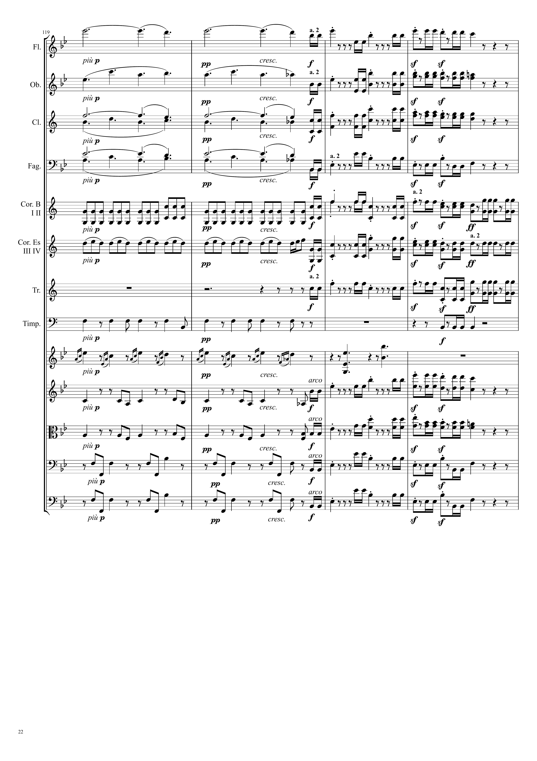
harm
mel
Ｘ
harm
mel
Ｘ
harm
harm
mel
Ｘ
harm
harm
mel
Ｘ
mel
Ｘ
harm
mel
Ｘ
harm
mel
Ｘ
harm
mel
Ｘ
mel
Ｘ
harm
harm
harm
mel
Ｘ
harm
harm
mel
Ｘ
harm
harm
mel
Ｘ
harm
mel
Ｘ

Slide 23
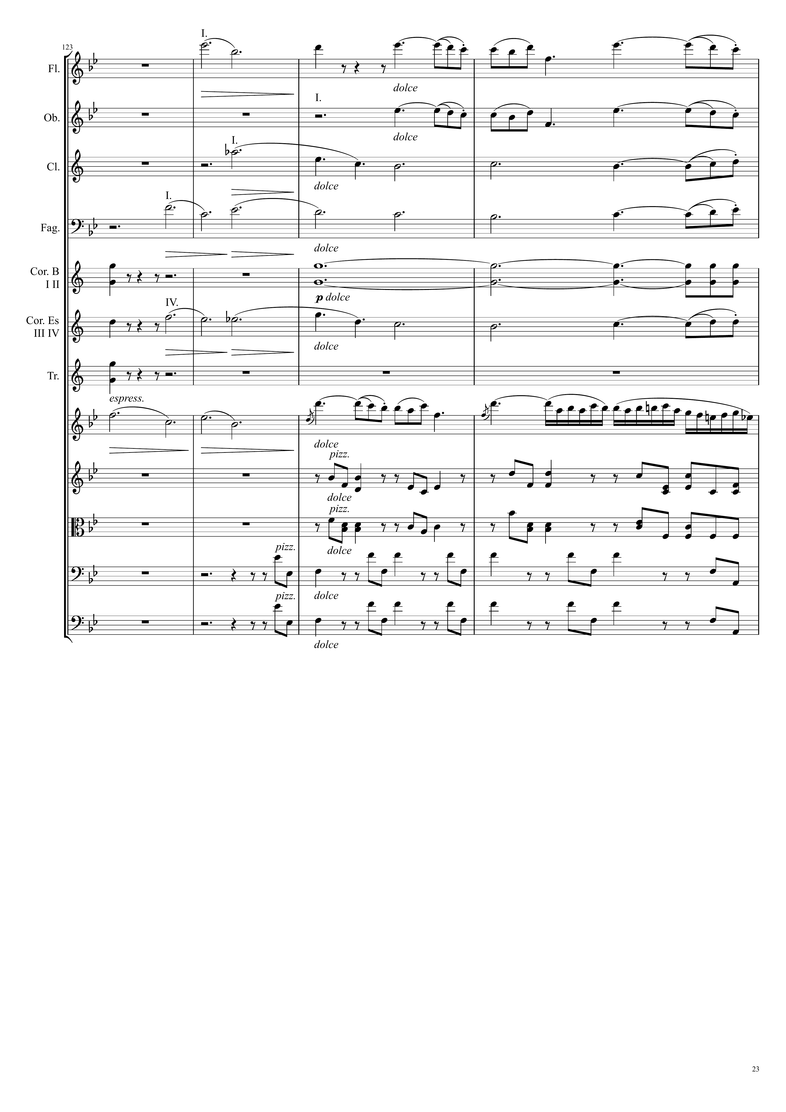
harm
mel
Ｘ
mel+harm
mel
Ｘ
mel+harm
harm
harm
mel
Ｘ
harm
mel
Ｘ
harm
mel
Ｘ
mel
Ｘ
harm
harm
harm
harm

Slide 24
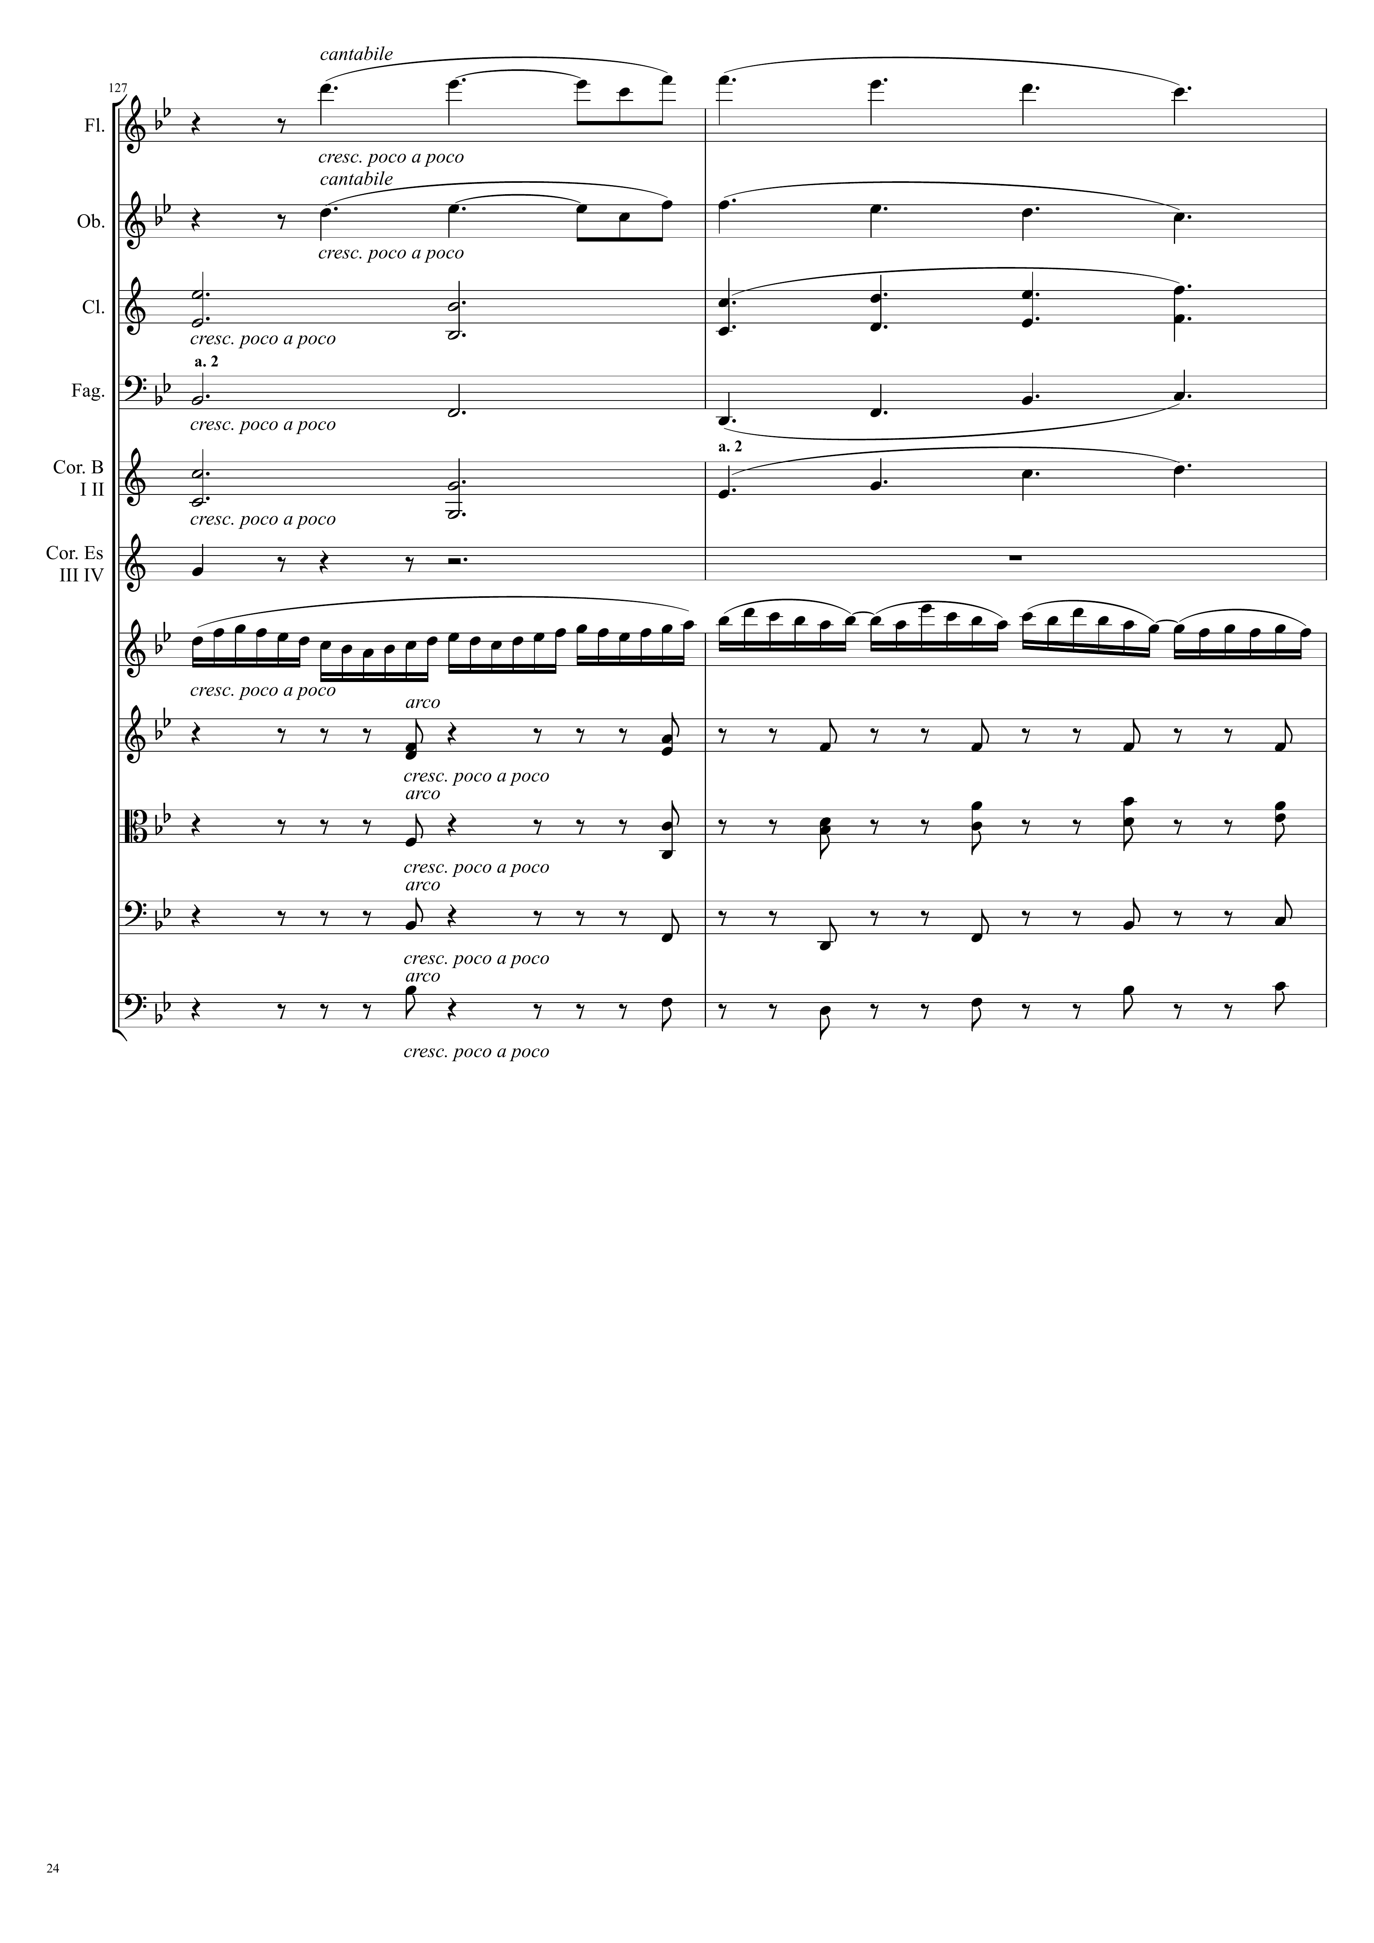
mel+harm
mel+harm
harm
harm
harm
harm
mel
Ｘ
harm
harm
harm
harm

Slide 25
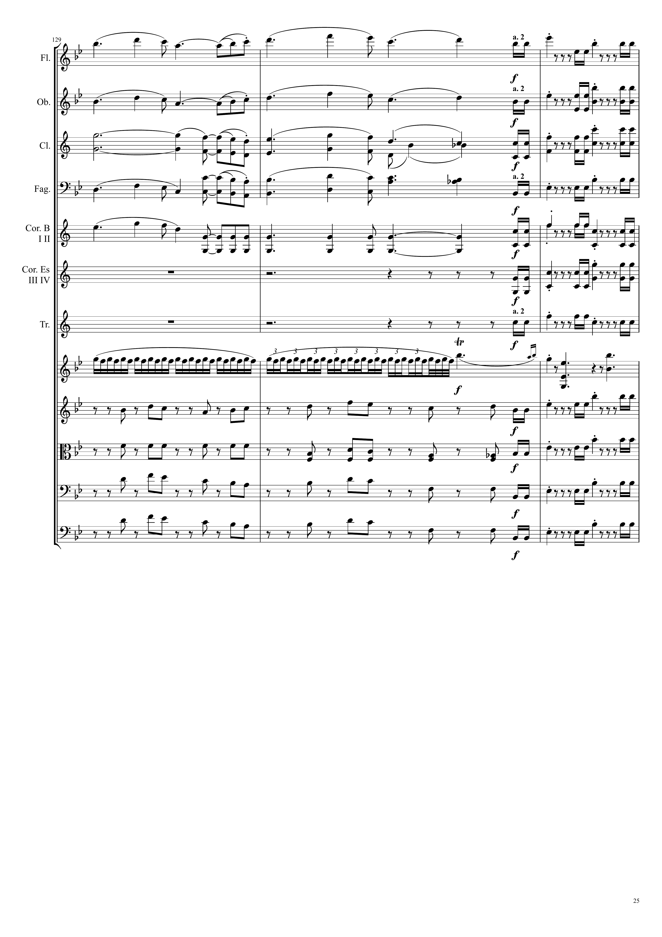
mel+harm
mel
Ｘ
harm
mel+harm
mel
Ｘ
harm
harm
mel
Ｘ
harm
harm
mel
Ｘ
harm
mel
Ｘ
harm
mel
Ｘ
mel
Ｘ
mel+rhythm
harm
harm
mel
Ｘ
harm
harm
mel
Ｘ
harm
harm
mel
Ｘ
harm
mel
Ｘ

Slide 26
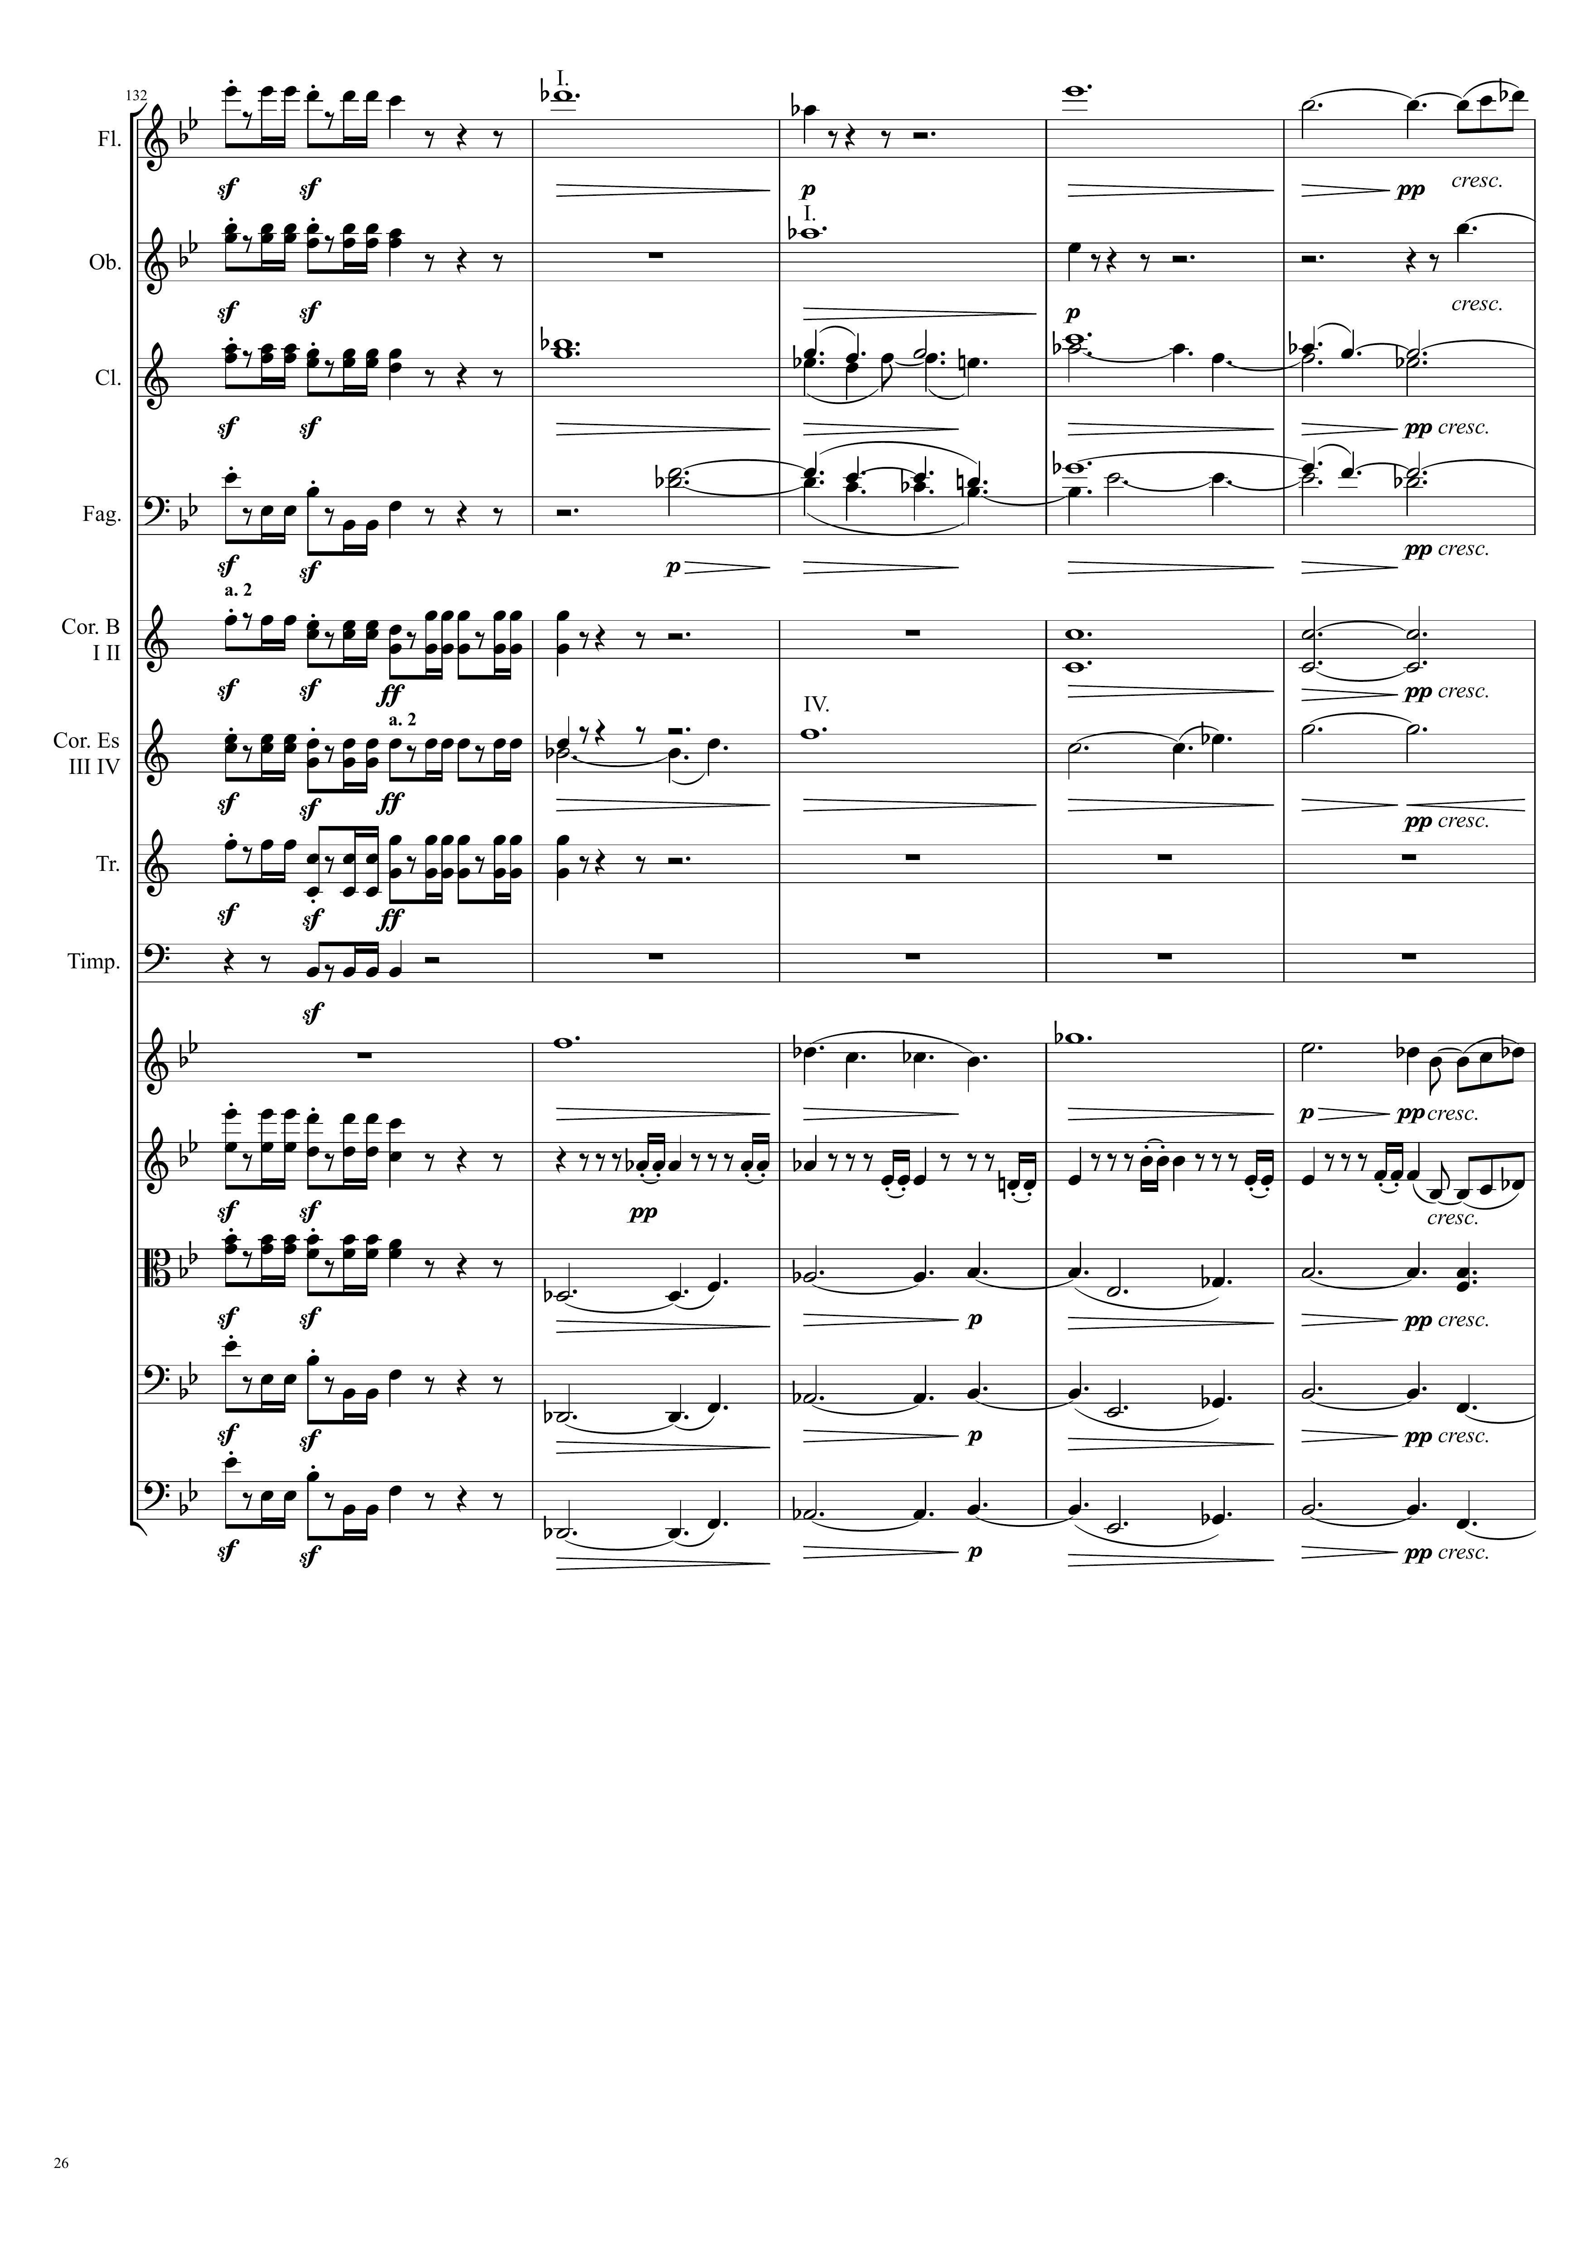
harm
mel
Ｘ
harm
harm
harm
mel+harm
mel
Ｘ
mel
Ｘ
harm
mel+harm
mel
Ｘ
harm
mel
Ｘ
harm
mel
Ｘ
harm
mel
Ｘ
harm
mel
Ｘ
harm
mel+harm
mel
Ｘ
harm
mel
Ｘ
harm
mel
Ｘ
harm

Slide 27
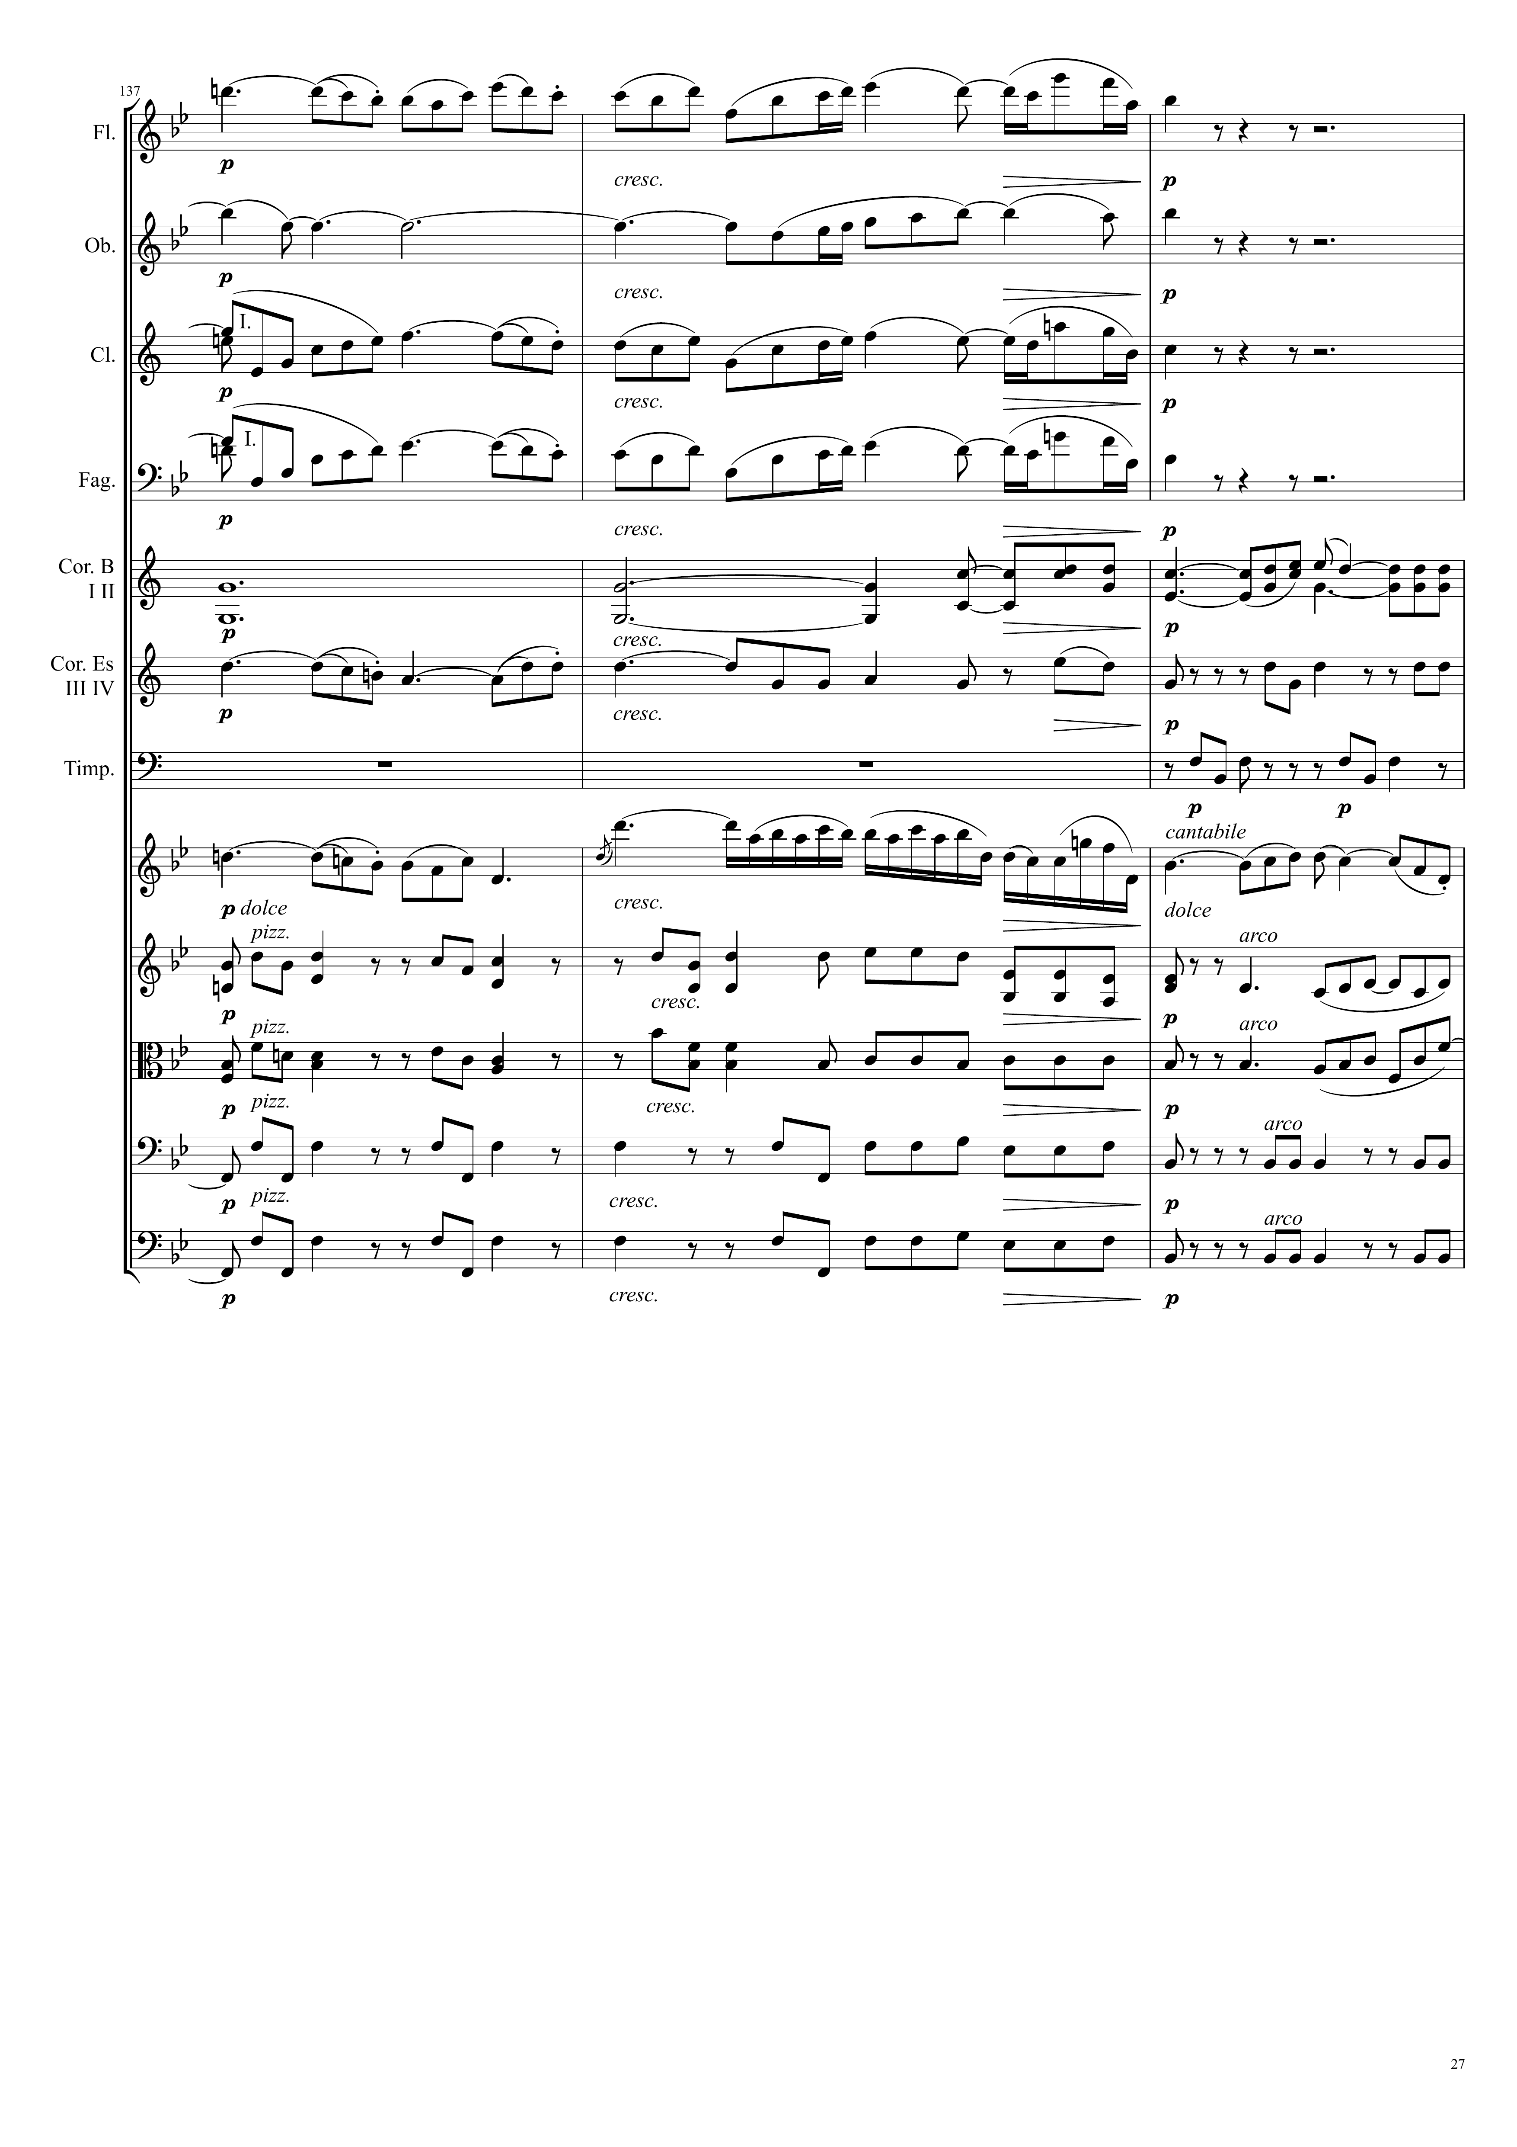
mel
Ｘ
mel
Ｘ
mel
Ｘ
mel
Ｘ
harm
mel
Ｘ
harm
mel
Ｘ
harm
harm
mel
Ｘ
harm
harm
harm
harm

Slide 28
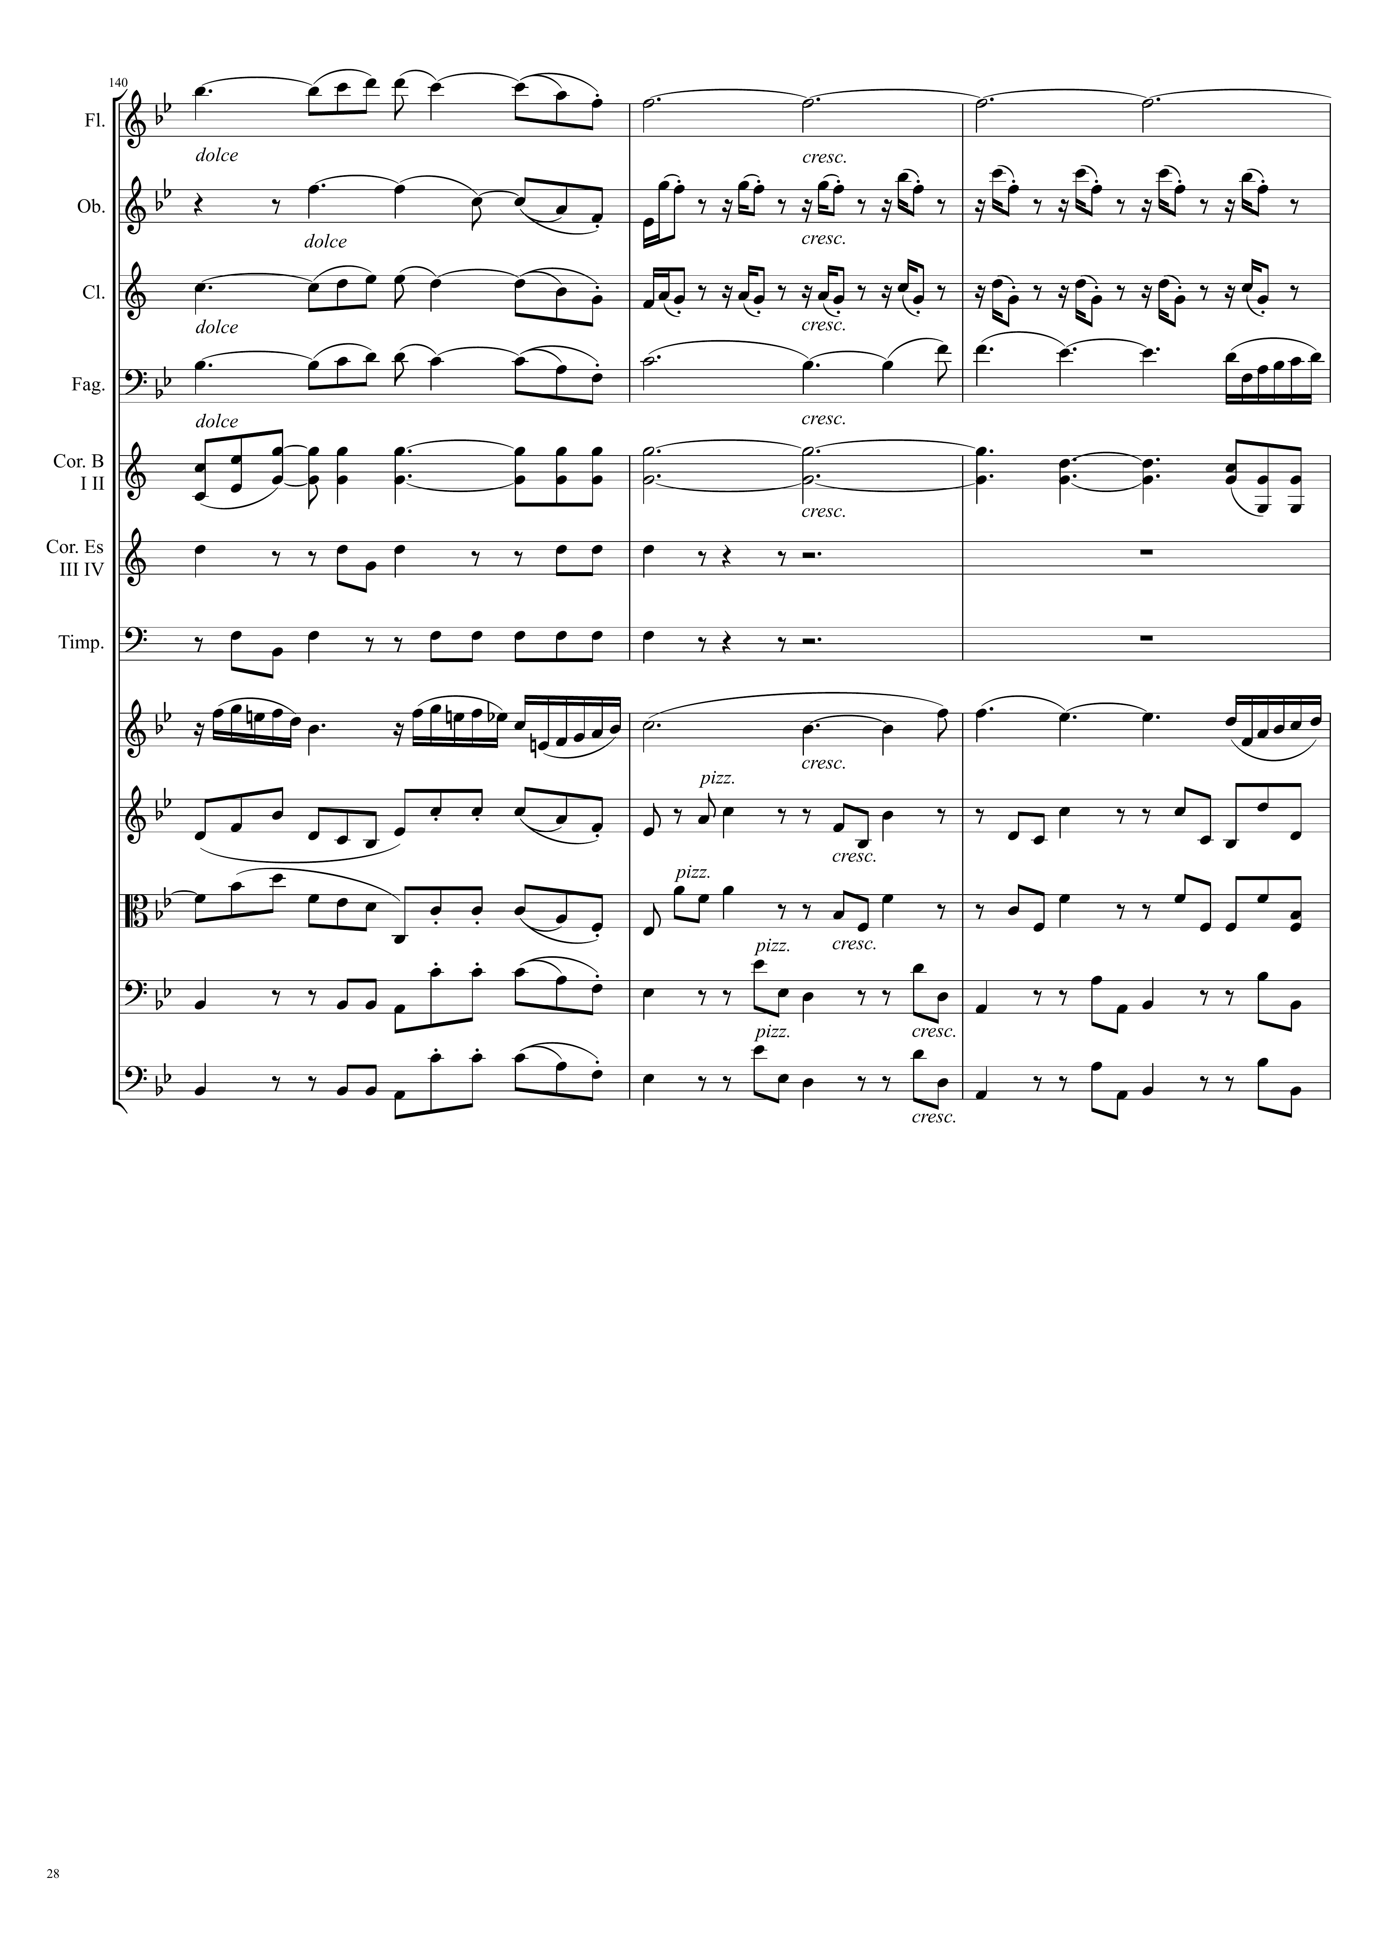
mel
Ｘ
harm
harm
mel
Ｘ
harm
mel
Ｘ
harm
mel
Ｘ
harm
mel
Ｘ
harm
harm
harm
mel+rhythm
mel
Ｘ
harm
mel
Ｘ
harm
harm
mel
Ｘ
harm
harm
mel
Ｘ
harm
harm
mel
Ｘ
harm

Slide 29
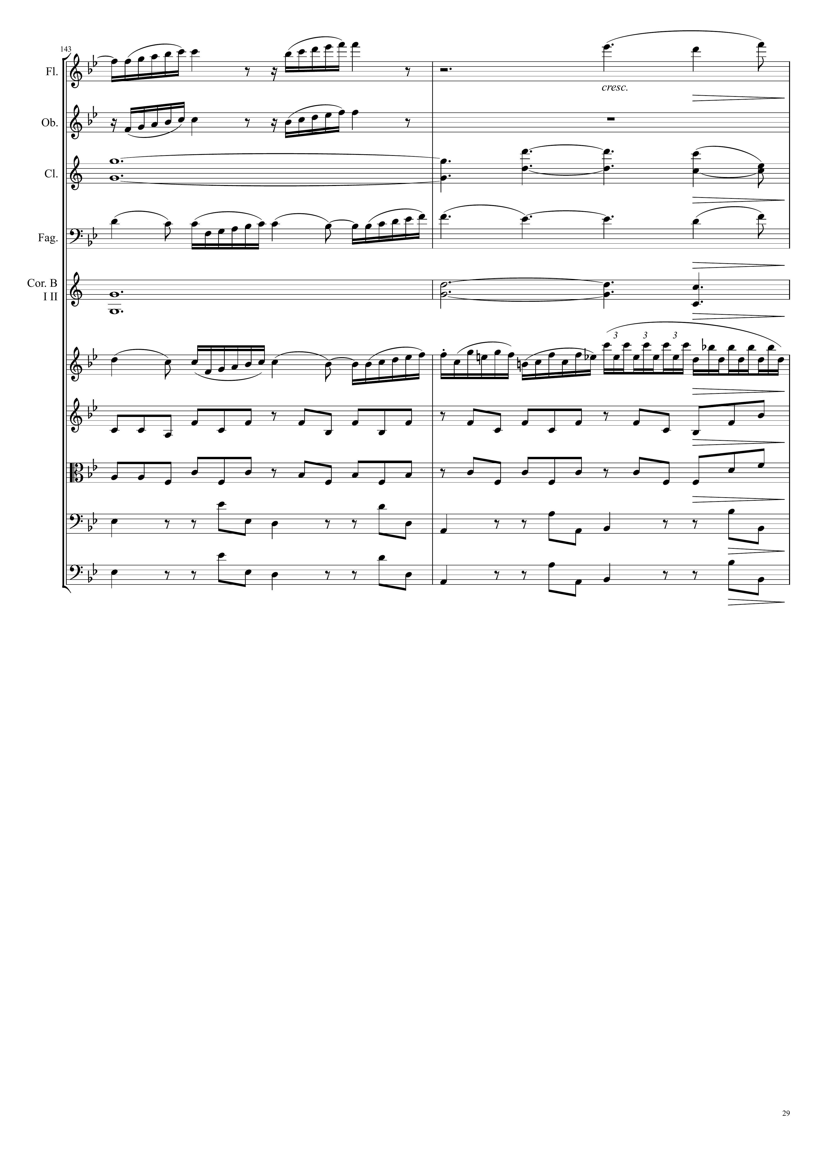
mel
Ｘ
harm
mel
Ｘ
harm
mel
Ｘ
mel+harm
harm
mel
Ｘ
harm
harm
harm
harm

Slide 30
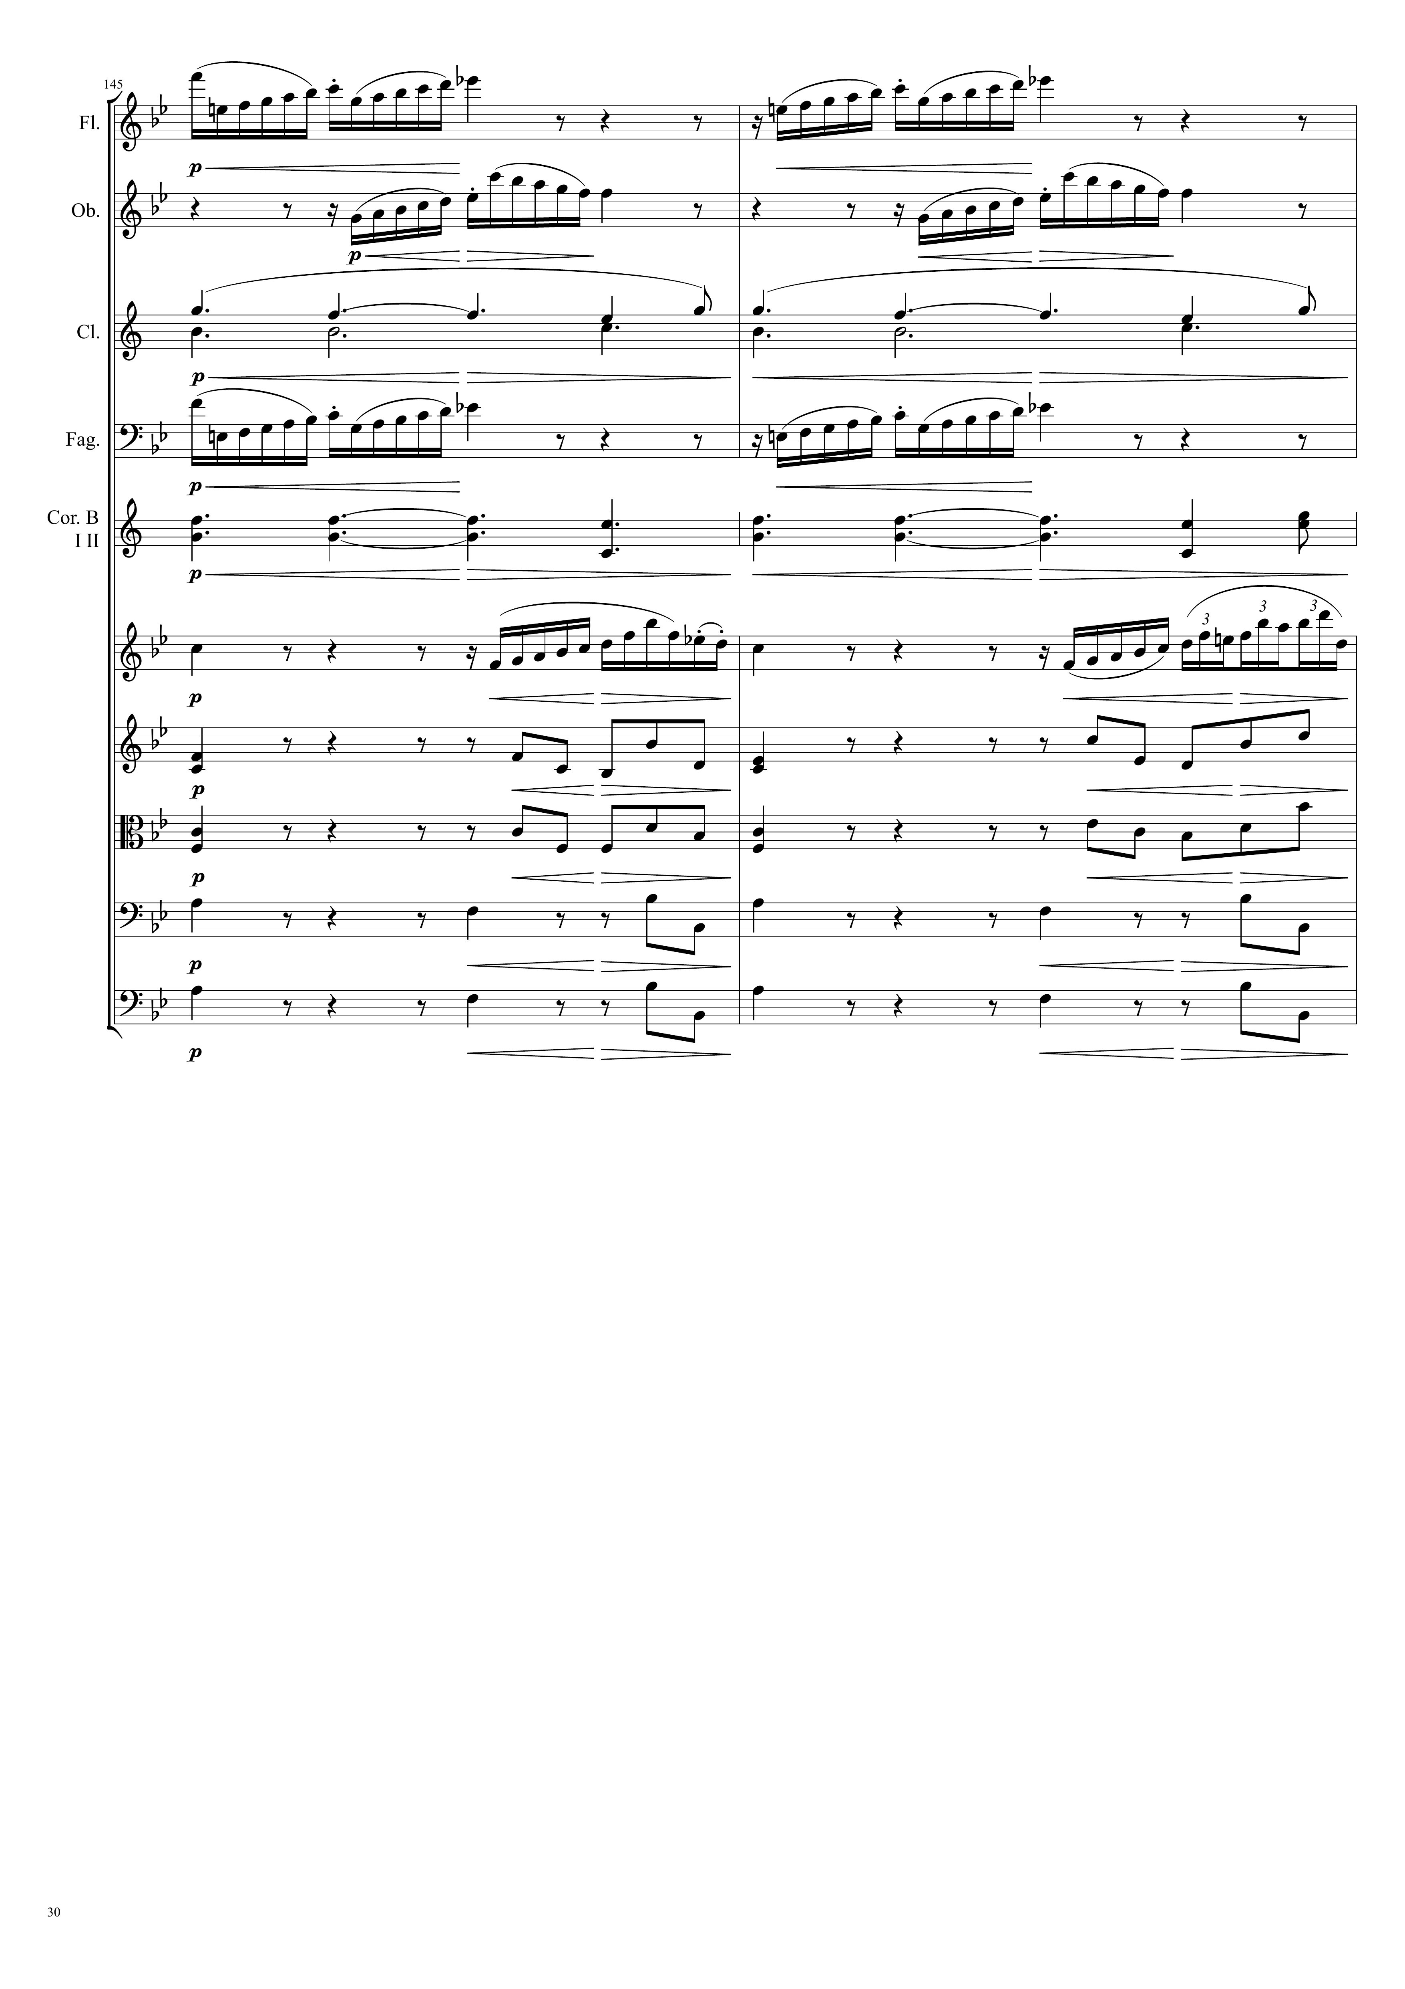
mel
Ｘ
mel
Ｘ
mel
Ｘ
mel
Ｘ
harm
mel
Ｘ
mel
Ｘ
harm
mel
Ｘ
mel
Ｘ
mel
Ｘ
harm
harm
harm
harm

Slide 31
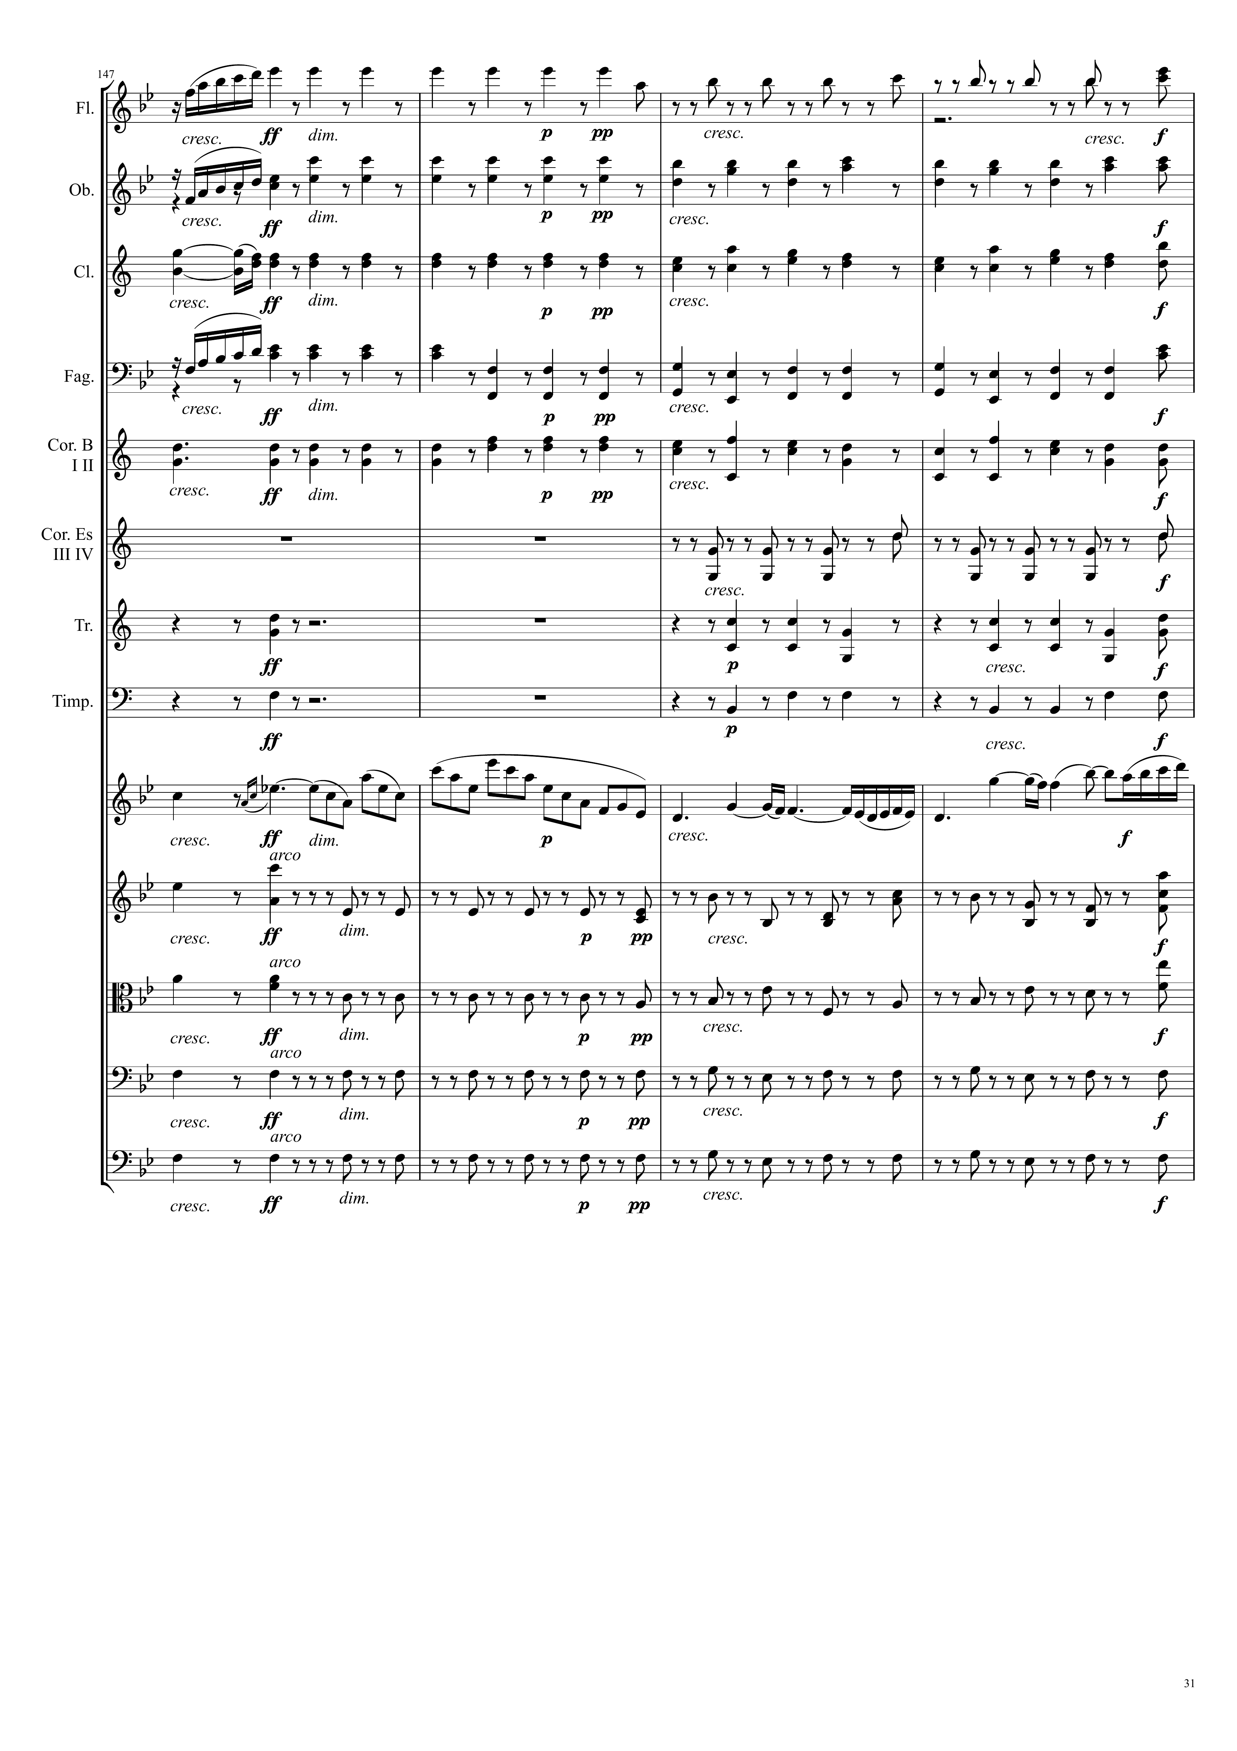
mel
Ｘ
harm
mel
Ｘ
harm
harm
mel
Ｘ
harm
harm
harm
harm
harm
harm
harm
mel
Ｘ
harm
harm
harm
harm

Slide 32
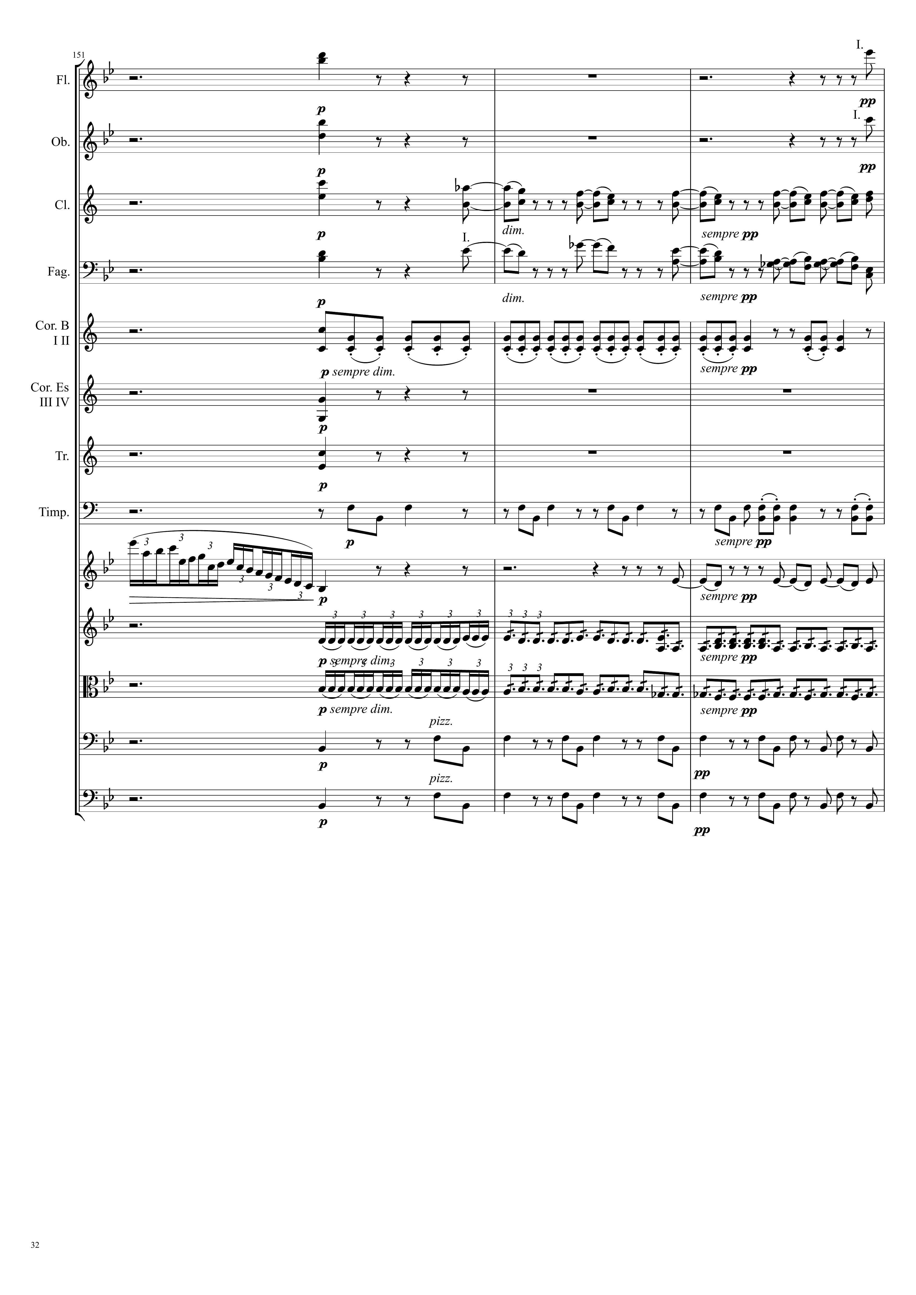
harm
mel
Ｘ
harm
mel
Ｘ
harm
mel
Ｘ
harm
mel
Ｘ
harm
harm
harm
mel
Ｘ
mel
Ｘ
mel
Ｘ
rhythm
rhythm
mel
Ｘ
mel
Ｘ

Slide 33
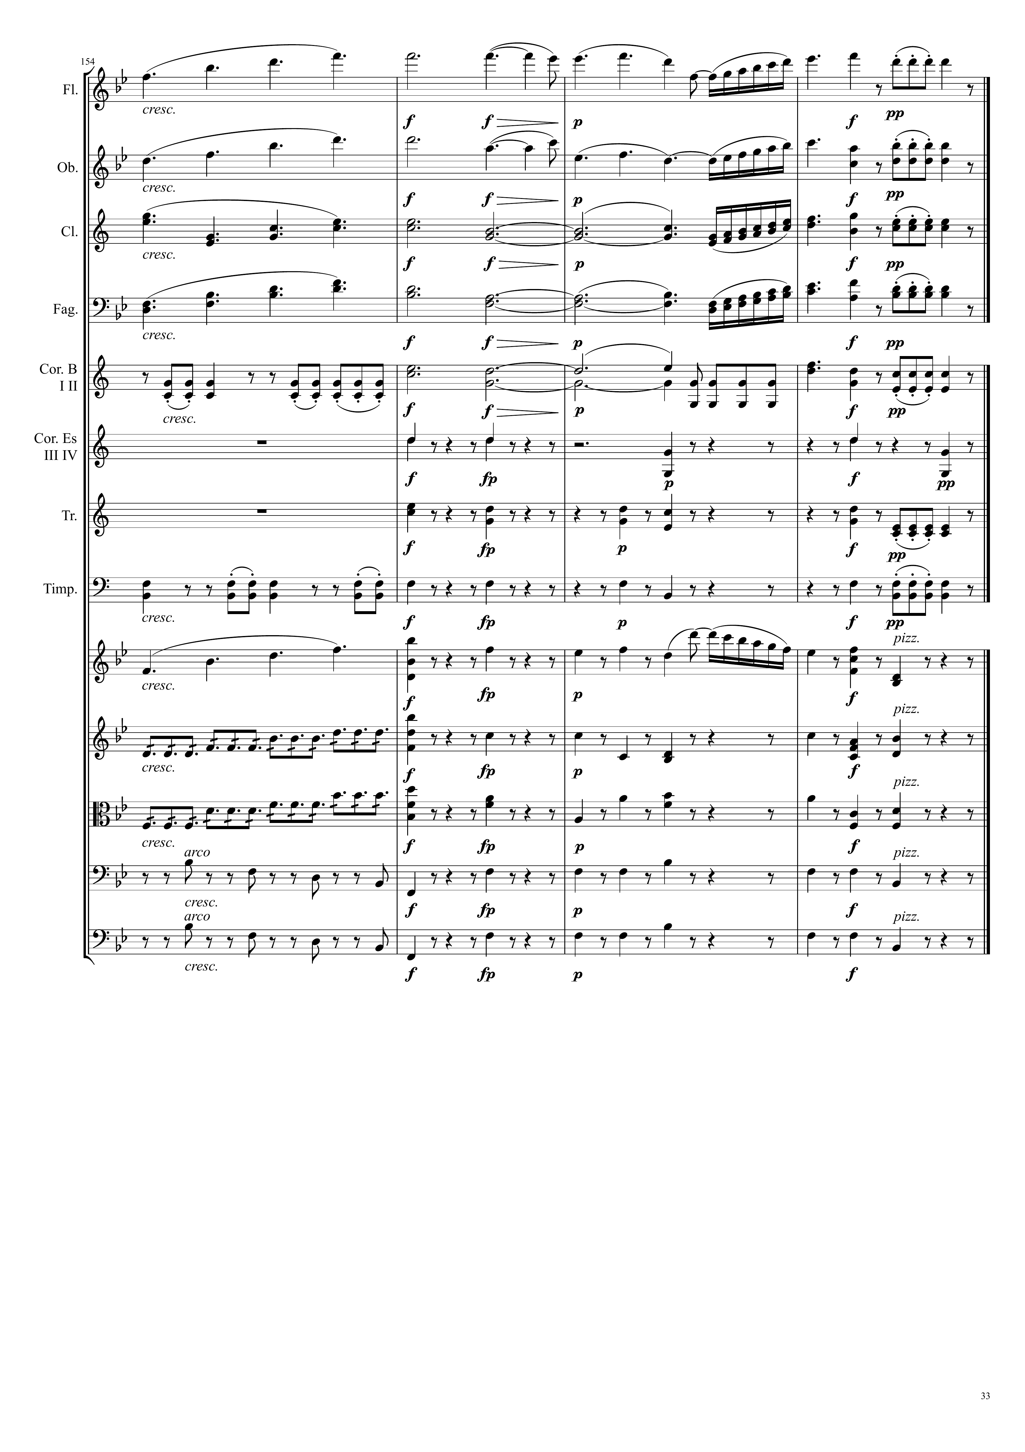
mel
Ｘ
mel
Ｘ
mel
Ｘ
harm
mel
Ｘ
mel
Ｘ
harm
mel
Ｘ
harm
mel
Ｘ
harm
harm
mel
Ｘ
harm
mel
Ｘ
mel
Ｘ
harm
rhythm
harm
rhythm
harm
harm
harm

